Slide 1
Success Boston Coaching: College Persistence and Completion
October 13, 2021
Tamara Linkow, Kelly Lack, Tori Morris, Erin Bumgarner, Austin Nichols, Beth Gamse

Slide 2
Policy Context
Access to jobs—and to the middle class—increasingly requires postsecondary credentials¹
BPS graduates are disproportionately from groups traditionally underrepresented in postsecondary education² and can face social, academic, logistical, and financial barriers to succeeding in college³
54% of Boston’s 2012 high school graduates who enrolled in college graduated within 6 years,⁴ which likely is insufficient to meet the predicted demand for a college-educated workforce
1: Bureau of Labor Statistics 2019; Scott and Nightingale 2018, 2: BPS 2019, 3: Arnold et al. 2009; Avery, Howell, and Page 2014; Bozick and DeLuca 2011; Castleman, Arnold, and Wartman 2012; Castleman, Page, and Schooley 2014; Engle and Tinto 2008; Roderick et al. 2008, 4. Boston Opportunity Agenda 2021

Slide 3
Citywide collaboration among the Boston Foundation, Boston Public Schools, City of Boston, local nonprofits, and local colleges to support college completion
Promote evidence-based practices to help students succeed in higher education and prepare to enter workforce
Core component is transition coaching to Boston high school graduates enrolling in local 2-year and 4-year colleges

Slide 4
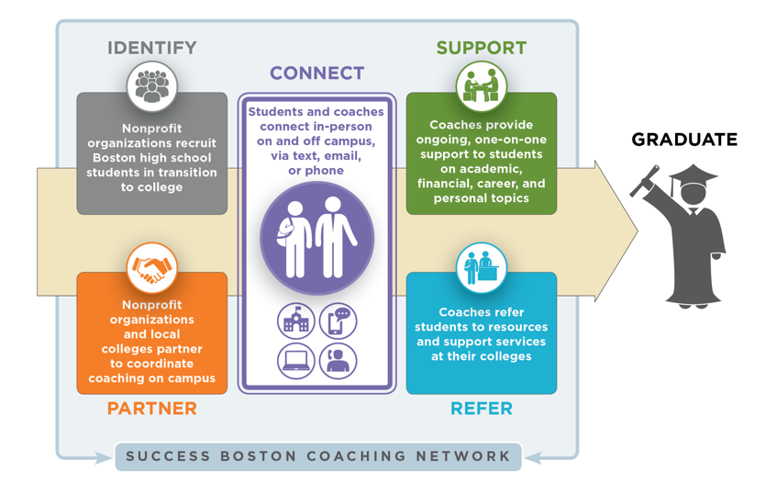
Success Boston Coaching Model

Slide 5
Research Questions
Overall Impacts:
What are the effects of SBC on students’ completion, persistence, and credit accumulation?
Differences in Impacts:
How, if at all, do the impacts of SBC differ by student characteristics?

Slide 6
Study Design
Analysis focuses on 4 cohorts of students, entering college in 2013 or 2014 (pre-scale-up) or 2015 or 2016 (post-scale-up)
Quasi-experimental design that compares outcomes of SBC students with similar non-coached students
Examines completion, persistence, and credit accumulation after 4 to 6 years

Slide 7
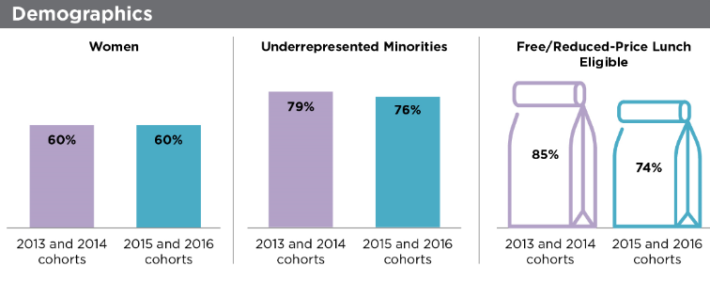
Characteristics of SBC Students and Non-Coached Peers

Slide 8
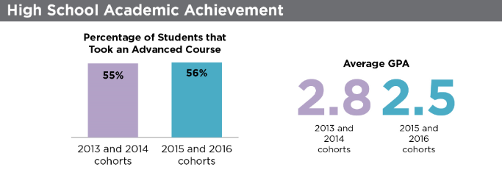
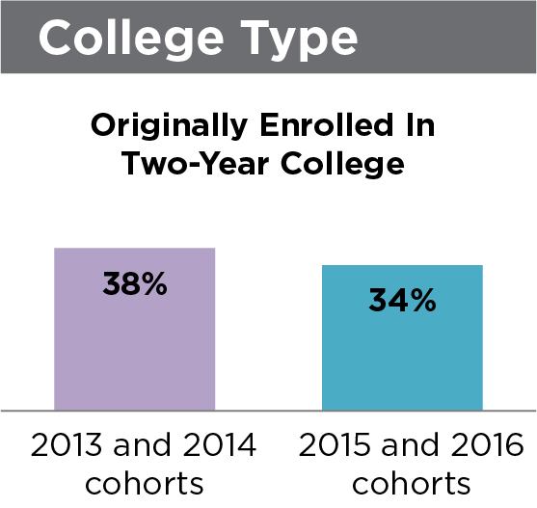
Characteristics of SBC Students and Non-Coached Peers

Slide 9
Data Sources
11 Boston area colleges
Program Database

Slide 10
Completion

Slide 11
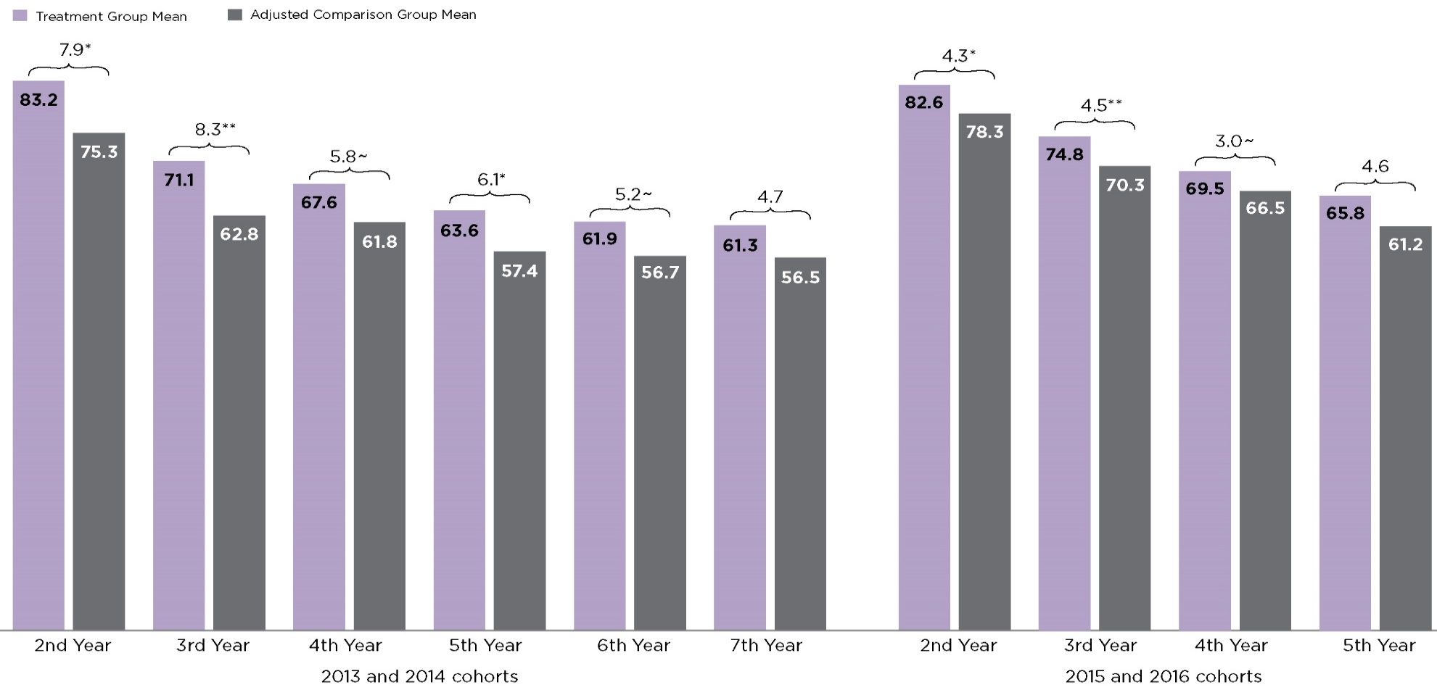
Persistence, including completions
~ Impact is significant at the 10 percent level. * Impact is significant at the 5 percent level. ** Impact is significant at the 1 percent level.

Slide 12
Credit Accumulation
* Impact is significant at the 5 percent level

Slide 13
Differences in Impacts by Student Characteristics
Examined differences in coaching impacts by student characteristics
Gender
Underrepresented minority status
High school GPA
Two vs. four-year college attendance
No consistent patterns found
Study Design

Slide 14
Takeaway 1: Systematic improvements and scale-up could explain smaller effects on later cohorts
Impacts of transition coaching for the post-scale-up cohorts are smaller than the impacts on the pre-scale-up cohorts
Why are we seeing this trend?
Improvements in support services offered to SBC and non-SBC students
During scale-up SBC is serving students enrolled at more colleges and more widely dispersed colleges (26 colleges pre-scale-up, 47 colleges post-scale-up)

Slide 15
Takeaway 2: Students stay enrolled while receiving coaching but more support could be helpful
SBC appears effective while the coaching is ongoing and perhaps shortly after coaching ends, but the effects fade as more time elapses.
After 4 years SBC students have earned slightly more than half the credits needed to graduate. We see no significant effect on completion.
Why are we seeing this trend?
We examined evaluations of other college coaching or advising programs

Slide 16
Effective coaching programs generally offer financial assistance, some have other supports or participation requirements
Program Name (Study) | Program/ College Type | Duration, Frequency of Coaching (typical/average) | Financial Support Provided | Transportation, Other Financial or In-Kind Supports | Participation Requirements | Positive Impacts
ASAP (Scrivener et al. 2015; Gupta 2017; Miller et al. 2020) | 2-year | Up to 3 years; 8x+ (semesters 1 and 2), 6x+ (semesters 3-5); 16-30 minutes/ session | Tuition waiver | Transportation subsidy Free use of textbooks Access to individual career and employment services Tutoring | Full-time Tutoring if GPA falls below 2.0 (CUNY ASAP only) | • Enrollment and full-time enrollment • Persistence • Credits earned • Associate's degree completion
Dell Scholars (Page et al. 2019) | 4-year | Up to 4 years | Up to $20,000 | Laptop Textbooks | No information provided | • Persistence • Bachelor's degree completion
Project Quest (Roder and Elliot 2020) | Certificate and 2-year | Up to 2 years of college through job placement | Tuition and fees | Transportation subsidy Textbooks Uniforms Licensing exams Tutoring | Full-time (after remedial courses and prerequisites) | • Enrollment and full-time enrollment • Persistence • Credential completion

Slide 17
Future Considerations
Coaching seems to be helping students in their early years of college, but current model may not provide enough support to help them graduate
Additional program supports or components might help more SBC students overcome barriers to completion and cross the finish line:
a financial aid component
additional program requirements
longer and/or more intensive services

Slide 18
Next Steps
Follow more cohorts of students 6 years after college entrance
Focus on degree/credential completion
Next report scheduled for release in 2022

Slide 19
Supplemental Slides

Slide 20
Coaching Intensity
One-on-one coach-student interactions in 2015-16
Average number: 6 Number of interactions vary by student—most students met with coach at least once per semester
Typical length: 34 minutes One-on-one interactions tended to last between 25 and 45 minutes
Average of one-on-one coaching per year= 3.5 hours

Slide 21
Proportion of Students Who Were Matched
 | 2013 and 2014 cohorts |  |  | 2015 and 2016 cohorts
 | Completion in 4, 5 Years; Persistence into 2nd, 3rd, 4th, 5th, 6th Years | Completion in 6 Years; Persistence into 7th Year | Credit Accumulation | Persistence into 2nd, 3rd, and 4th Years | Persistence into 5th Year | Credit Accumulation
Matched SBC students (n) | 678 | 302 | 649 | 1,234 | 561 | 838
Matched SBC students (%) | 95 | 93 | 95 | 83 | 83 | 85
Matched non-SBC students (n) | 1,834 | 801 | 1,517 | 4,629 | 2,158 | 2,841
Matched non-SBC students (%) | 82 | 81 | 96 | 52 | 50 | 82

Slide 22
Subgroup Differences in Completion, By Gender and Underrepresented Minority Status
Completion in … | Treatment Group Mean | Adjusted Comparison Group Mean | Program Impact | Treatment Group Mean | Adjusted Comparison Group Mean | Program Impact
 | Female |  |  | Male |  |  | Difference
4 years of college | 27.72 | 26.47 | 1.25 | 19.71 | 18.36 | 1.35 | -0.10
5 years of college | 48.27 | 47.34 | 0.93 | 35.77 | 33.00 | 2.76 | -1.83
6 years of college | 57.80 | 49.79 | 8.01 | 40.31 | 41.05 | -0.74 | 8.75
 | Underrepresented Minority |  |  | Not Underrepresented Minority |  |  | Difference
4 years of college | 20.23 | 20.44 | -0.21 | 38.96 | 31.97 | 6.99 | -7.20
5 years of college | 37.4 | 38.15 | -0.75 | 62.99 | 52.17 | 10.82 | -11.57
6 years of college | 43.83 | 42.16 | 1.67 | 73.13 | 59.53 | 13.6 | -11.93

Slide 23
Subgroup Differences in Completion, By High School GPA and College Type
Completion in … | Treatment Group Mean | Adjusted Comparison Group Mean | Program Impact | Treatment Group Mean | Adjusted Comparison Group Mean | Program Impact
 | High GPA in High School |  |  | Low GPA in High School |  |  | Difference
4 years of college | 36.52 | 32.18 | 4.34 | 15.32 | 16.32 | -1.00 | 5.34
5 years of college | 61.77 | 60.56 | 1.22 | 29.09 | 27.47 | 1.62 | -0.40
6 years of college | 68.84 | 64.86 | 3.98 | 34.76 | 30.87 | 3.89 | 0.09
 | Initially Enrolled at a Two-Year College |  |  | Initially Enrolled at a Four-Year College |  |  | Difference
4 years of college | 14.12 | 16.90 | -2.78 | 30.73 | 26.95 | 3.78 | -6.56
5 years of college | 19.61 | 22.77 | -3.16 | 57.45 | 52.80 | 4.64 | -7.80
6 years of college | 26.27 | 29.45 | -3.18 | 65.76 | 56.53 | 9.23 | -12.42

