Slide 1



First 1,000 Days & Beyond:
Implications for the Early Childhood Field
Elsie M. Taveras, M.D., M.P.H
Chief Community Health Equity Officer, Mass General Brigham
Executive Director, Kraft Center for Community Health, MGH
Conrad Taff Endowed Chair and Professor of Pediatrics, Harvard Medical School
November 4, 2021
Notes:
Title of presentation
Roles
MGB logo?

Slide 2
Agenda
The First 1,000 Days Program Overview
Program Reach and Research Findings
Key Insights and Implications
Notes:
Come back to

Slide 3
Prevalence of Obesity in US Children Aged 2 to 19 Years by Race and Hispanic Origin, 2017-2018
ALL CHILDREN
19.3 %
NON-HISPANIC WHITE
16.1 %
Racial and ethnic disparities in obesity are already present by the age of two and persist into adulthood
NON-HISPANIC BLACK
24.2 %
NON-HISPANIC ASIAN
8.7 %
HISPANIC
25.6 %
Citation: Fryar CD, et al. Prevalence of overweight, obesity, and severe obesity among children and adolescents aged 2–19 years: United States, 1963–1965 through 2017–2018. NCHS Health E-Stats. 2020.

Slide 4
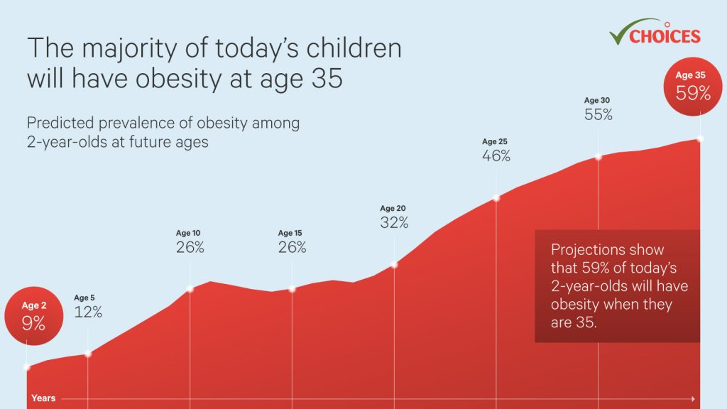

Slide 5
Selected Determinants of Childhood Obesity
Gestational weight gain & GDM
Maternal smoking during pregnancy
Microbiome alterations
Gene-environment interactions
Rapid infant weight gain
Breastfeeding
Sleep duration and quality
Television viewing & TV in bedrooms
Responsiveness to infant hunger and satiety cues
Parental feeding practices, eating in the absence of hunger
Portion sizes
Fast food intake
Sugar-sweetened beverages
Physical inactivity
Socio-cultural, recreation, & transport environments
Food & marketing environments

Slide 6
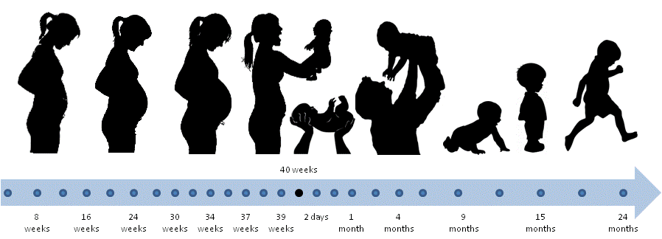
First 1,000 Days
The First 1,000 Days is a critical period during which exposures to a complex array of factors can influence lifelong health and development.

Slide 7
The First 1,000 Days: Conception to Age 2
Growing body of evidence shows that the first 1,000 days are critical times in the developing fetus, infant, or young child that influence:
  Child development, effective learning, adaptive behaviors, lifelong health and well-being;
  Overweight, obesity, type II diabetes, and cardiovascular health.

Slide 8
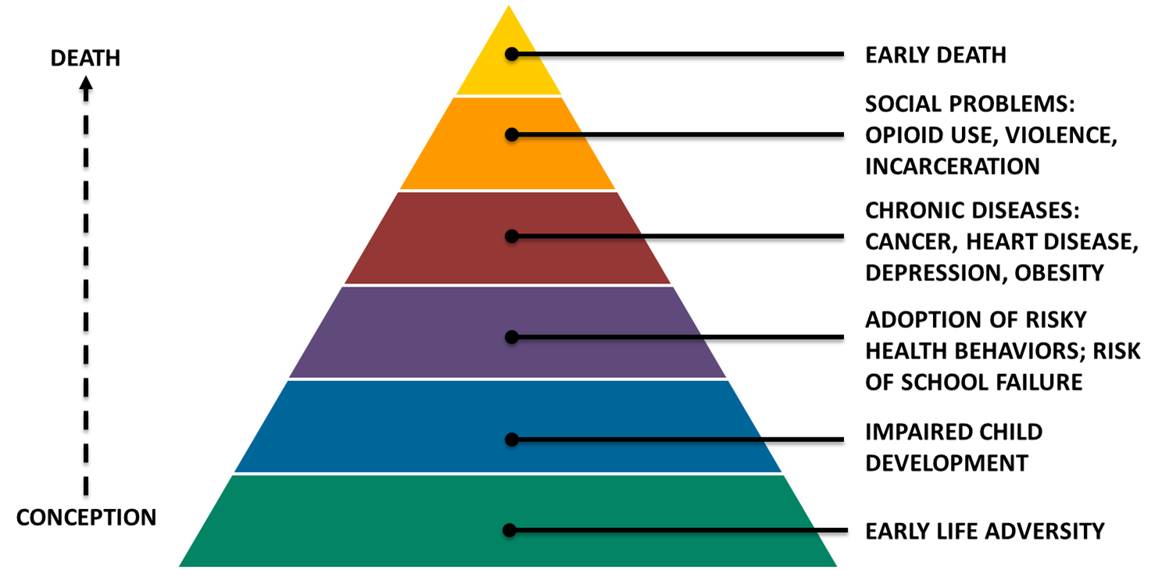
Early Life Adversity Influences Health Throughout Life

Slide 9
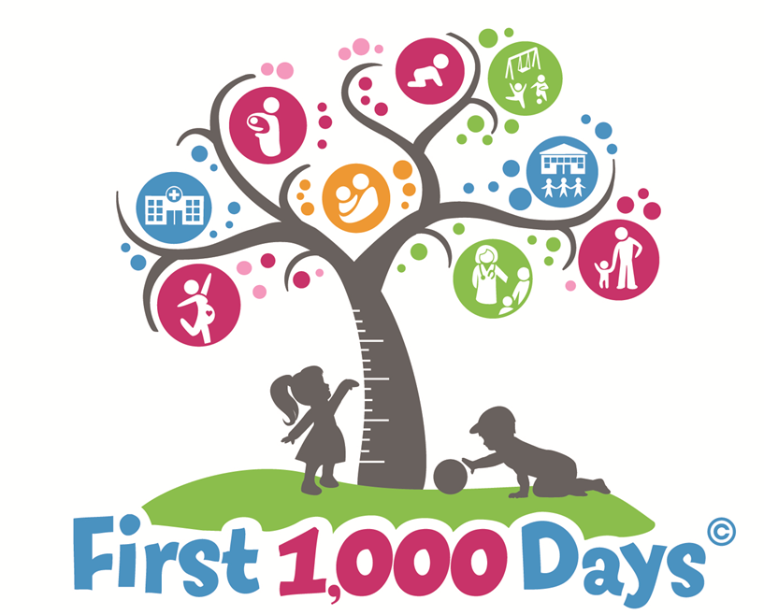


Slide 10
First 1,000 Days Program Premise
Achieving equity in early child health & development requires:
  Alignment of individuals and organizations from multiple sectors to achieve collective impact;
  Leveraging emerging science to drive approaches to systems change;
  Creating an early childhood ecosystem that supports “disruptive innovation” and scaling of best practices.

Slide 11
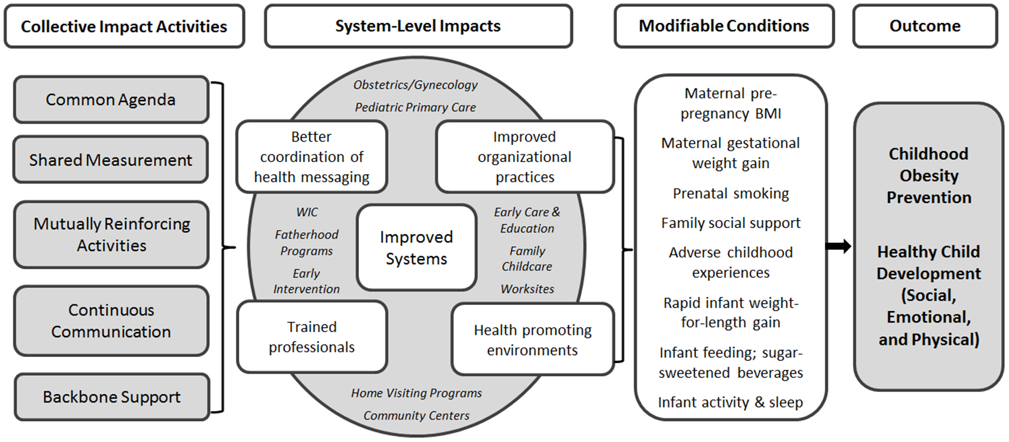
Systems-Level Approach to Early Childhood Health & Development

Slide 12

First 1,000 Days Logic Model
Citation: Blake-Lamb T, Boudreau AA, Matathia S, et al. Strengthening integration of clinical and public health systems to prevent maternal-child obesity in the First 1,000 Days: A Collective Impact approach. Contemporary clinical trials. 2018;65:46-52.

Slide 13



Implementation Sites
MGH Chelsea HealthCare Center
Health Center Demographics:
~500 women per year receiving prenatal care
68% pregnant women enter pregnancy overweight or obese
Community Demographics:
64% Hispanic
Median income for families with children: $43,000
23% families with kids <5 live under the Federal Poverty Level
50% children live in households with public assistance
70% speak language other than English at home

Slide 14



Implementation Sites
MGH Revere HealthCare Center
Health Center Demographics:
~300 women per year receiving prenatal care
60% pregnant women enter pregnancy overweight or obese
Community Demographics:
26% Hispanic
Median income for families with children: $51,213
28% families with kids <5 live under the Federal Poverty Level
30% children live in households with public assistance
49% speak language other than English at home

Slide 15


Implementation Sites
DotHouse Health
Health Center Demographics:
~200 women per year receiving prenatal care
45% pregnant women enter pregnancy overweight or obese
Community Demographics:
46% Black/African American, 18% Hispanic
Median income for families with children: $36,402
22% families with kids <5 live under the Federal Poverty Level
54% children live in households with public assistance
41% speak language other than English at home

Slide 16
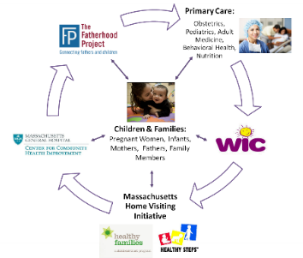
First 1,000 Days Program Components
  Universal screening of social and behavioral needs in pregnancy and from birth to age 2 years;
  Training and alignment of clinicians and staff on health promotion and disease prevention;
  Enhanced tracking of gestational weight gain and infant growth in health record;
  Patient navigation, care coordination, resource sheets, text messaging, and educational materials to support behavior change and social needs;
  Individualized health coaching for parents at high risk of obesity or infants with rapid weight gain.

Slide 17
First 1,000 Days Health Education Materials
Citation: Blake-Lamb T, Boudreau AA, Matathia S, et al. Strengthening integration of clinical and public health systems to prevent maternal-child obesity in the First 1,000 Days: A Collective Impact approach. Contemporary clinical trials. 2018;65:46-52.

Slide 18

Program Reach
Enrolled 892 women at their first prenatal visit;
131 partners/fathers also enrolled to receive support;
711 mother-infant pairs continued the program after the birth of their infant or were newly enrolled;
  97% received educational materials and resource sheets.
  83% received patient navigation or care coordination calls.
  42% were considered high risk. Of these families, 82% received individualized health coaching.
  67% enrolled in text messaging.
Notes:
Do you want to keep this? If so, I will verify numbers and update.

Slide 19
Main Research Findings
Maternal pregnancy and postpartum outcomes:
  Excess gestational weight gain in pregnancy
  Weight retention at 6 weeks postpartum
  Receipt of care at 6 weeks postpartum
Infant weight outcomes at 6 and 12 months:
  Weight-for-length z-score
  Overweight (weight-for-length ≥97.7th percentile)
  Conditional Weight Gain
Notes:
ADD:
Meg’s 1-3^{rd:} Obesogenic health behaviors and psychosocial outcomes improved 1st to 3rd trimester,
Cruz: Unintended pregnancies were associated with current stress, depression and delayed prenatal care in this sample of low-income women
Neri Fathers: Mothers had greater GWG when fathers report unhealthy dietary behaviors, even if mothers themselves report a healthy diet. Fathers had significant unmet basic and social needs

Slide 20
Maternal Gestational Weight Gain
A decrease of excess GWG among women with overweight, pre- to post-implementation
Greatest effects among women who engaged the most, vs. pre-implementation
Monitored for adverse birth outcomes. None detected.
 | Pre-Implementation (N=643) | Post-Implementation (N=928) | Adj odds of excess GWG | P-value
Excess GWG | % | % | OR (95% CI)
Pre-preg BMI<25 kg/m² | 29.6% | 28.9% | 1.04 (0.70, 1.52) | 0.86
Pre-preg BMI ≥25 to <30kg/m² | 55.8% | 46.4% | 0.69 (0.49, 0.99) | 0.04
Pre-preg BMI≥30 kg/m² | 41.3% | 45.9% | 1.20 (0.83, 1.75) | 0.34
 | Adj odds of excess GWG among women exposed to Systems-Change only (N=261) | Adj odds of excess GWG among women exposed to Systems-Change plus Coaching (N=533) | P for trend
Excess GWG | OR (95% CI) | OR (95% CI)
Pre-preg BMI < 25 kg/m² | 1.16 (0.68, 1.99) | 0.96 (0.61, 1.50) | 0.79
Pre-preg BMI≥25 to <30kg/m² | 0.83 (0.50, 1.39) | 0.64 (0.43, 0.96) | 0.09
Pre-preg BMI ≥ 30 kg/m² | 1.40 (0.82, 2.39) | 1.00 (0.66, 1.53) | 0.40

Slide 21
Maternal Postpartum Outcomes
Main Outcome | Unadjusted N (%) or Mean (SD) | Unadjusted | Adjustedª
Postpartum Weight Retention, kg (N=1,226) | Mean (SD) | Mean diff (95% CI) | Mean diff (95% CI)
Intervention Sites | 3.10 (5.55) | -0.32 (-0.97, 0.33) | -0.51 (-1.15, 0.13)
Comparison Sites | 3.43 (5.65) | 0.00 (Reference) | 0.00 (Reference)
Postpartum Visit Completion | N (%) | OR (95% CI) | OR (95% CI)
Intervention Sites | 818 (82.2%) | 1.56 (1.21, 2.01) | 1.50 (1.16, 1.94)
Comparison Sites | 400 (74.8%) | 1.00 (Reference) | 1.00 (Reference)

Slide 22
Infant Weight Outcomes
Main Outcome | Unadjusted N (%) or mean (SD) | Unadjusted | Adjustedª
6 Month Outcomes (N= 1518)
Weight-for-length z-score | Mean (SD) | Mean diff (95% CI) | Mean diff (95% CI)
Intervention Sites | 0.16 (1.05) | -0.15 (-0.27, -0.04) | -0.27 (-0.39, -0.15)
Comparison Sites | 0.31 (1.14) | 0.00 (Reference) | 0.00 (Reference)
Weight-for-length >=97.7%ile | N (%) | OR (95% CI) | OR (95% CI)
Intervention Sites | 33 (3.6%) | 0.56 (0.34, 0.90) | 0.46 (0.28, 0.76)
Comparison Sites | 37 (6.2%) | 1.00 (Reference) | 1.00 (Reference)
12 Month Outcomes (N= 1498)
Weight-for-length z-score | Mean (SD) | Mean diff (95% CI) | Mean diff (95% CI)
Intervention Sites | 0.41 (1.03) | -0.06 (-0.17, 0.05) | -0.18 (-0.30, -0.07)
Comparison Sites | 0.47 (1.10) | 0.00 (Reference) | 0.00 (Reference)
Weight-for-length >=97.7%ile | N (%) | OR (95% CI) | OR (95% CI)
Intervention Sites | 56 (6.2%) | 0.77 (0.52, 1.16) | 0.60 (0.39, 0.92)
Comparison Sites | 46 (7.8%) | 1.00 (Reference) | 1.00 (Reference)

Slide 23
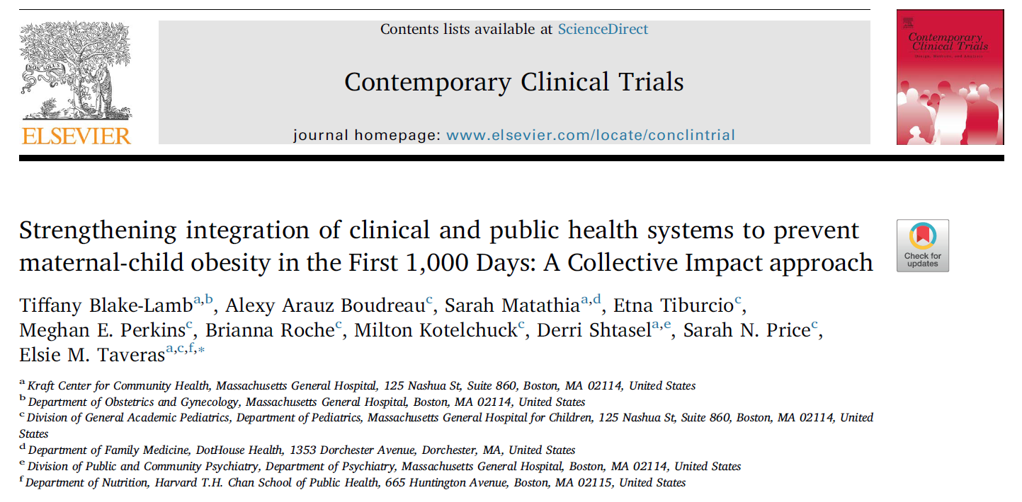


Manuscripts
Blake-Lamb T, Boudreau AA, Matathia S, Tiburcio E, Perkins ME, Roche B, Kotelchuck M, Shtasel D, Price SN, Taveras EM. Strengthening integration of clinical and public health systems to prevent maternal-child obesity in the First 1,000Days: A Collective Impact approach. Contemp Clin Trials. 2018 Feb;65:46-52.
Blake-Lamb T, Boudreau AA, Matathia S, Perkins ME, Roche B, Cheng ER, Kotelchuck M, Shtasel D, Taveras EM. Association of the First 1,000 Days Systems-Change Intervention on Maternal Gestational Weight Gain. Obstet Gynecol. 2020 May;135(5):1047-1057.
Taveras EM, Perkins ME, Boudreau AA, Blake-Lamb T, Matathia S, Kotelchuck M, Luo M, Price SN, Roche B, Cheng ER. Twelve-Month Outcomes of the First 1000 Days Program on Infant Weight Status. Pediatrics. 2021 Aug;148(2).
Neri Mini F, Saltzman JA, Simione M, Luo M, Perkins ME, Roche B, Blake-Lamb T, Kotelchuck M, Arauz-Boudreau A, Davison K, Taveras EM. Expectant Fathers’ Social Determinants of Health in Early Pregnancy. Glob Pediatr Health. 2020 Nov 27.
Cruz-Bendezú AM, Lovell GV, Roche B, Perkins M, Blake-Lamb TL, Taveras EM, Simione M. Psychosocial status and prenatal care of unintended pregnancies among low-income women. BMC Pregnancy Childbirth. 2020 Oct 12;20(1).
Simione M, Moreno-Galarraga L, Perkins M, Price SN, Luo M, Kotelchuck M, Blake-Lamb TL, Taveras EM. Effects of the First 1,000 Days Program, a Systems-Change Intervention, on Obesity Risk Factors During Pregnancy. (2021). BMC Pregnancy and Childbirth. In press.
Notes:
Alanna’s table 2

Slide 24
Key Outcomes
1. During pregnancy:
  Reduced odds of excessive gestational weight gain;
  Improvements in dietary and physical activity behaviors;
  Reduction in anxiety and stress;
  Increased participation in WIC & engagement in clinical care.
2. During first 12 months:
  High rates of breastfeeding (>85% at 1 month), engagement in WIC, Healthy Steps, and clinical care;
  Almost half the odds of unhealthy weight among infants at 12 months after program implementation.
Notes:
Table 5 form Jaci’s 4.9.19 tables file

Slide 25
Key Insights
High prevalence of unmet social needs, e.g. food and housing insecurity, and depression;
Over 2/3 of women enter pregnancy with obesity or overweight;
Fathers/partners also have high unmet needs but are not often engaged or supported;
Program is feasible to deliver, highly acceptable to families;
Clinicians and program staff require continuous support and training from a backbone organization for sustainability.
Notes:
Table 5 form Jaci’s 4.9.19 tables file

Slide 26
What Makes the First 1,000 Program Unique
Enrolled women during their first trimester of pregnancy
Targeted both individual- and systems-level changes
Built collaborations for obesity prevention across early-life clinical and public health services.
Leveraged existing clinical health information technology to link families across clinical disciplines and public health programs --more effective, efficient, and coordinated care for families

Slide 27
Implications for Early-Life Systems
Start early in pregnancy, if possible before conception
Implement both systems- and individual-level interventions
Focus on mother-father-child triad to improve maternal and child health outcomes
Cross-sector collaboration is necessary, both within the and outside the health system
Backbone organization to provide continuous support and training

Slide 28
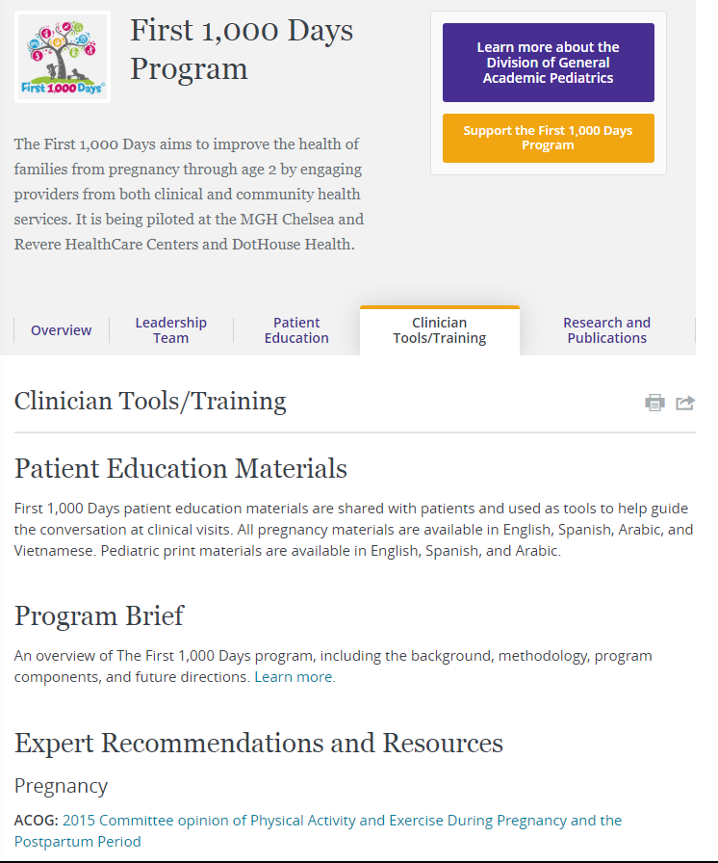
Next steps: Creating a First 1,000 Ecosystem
Sustain the existing program –
  All mothers screened for unmet needs at MGH
  All community health staff (i.e. community health workers and Healthy Steps) using resources
  Website is clearinghouse for all training and educational materials; toolkit in the works
    Educational videos to be uploaded onto YouTube
  Scale and expand through community health centers and Healthy Steps

Slide 29
Acknowledgements
Grant support from The Boston Foundation
Mentors, trainees, and research staff in:
  Department of Pediatrics, MGH
  Department of Nutrition, Harvard Chan School of Public Health

Slide 30
Contact information:
elsie.taveras@mgh.harvard.edu

