Slide 1
Vaccine Hesitancy
A Conversation for Early Education Leaders, Providers, Funders and Community Members
Pratima Patil

Slide 2
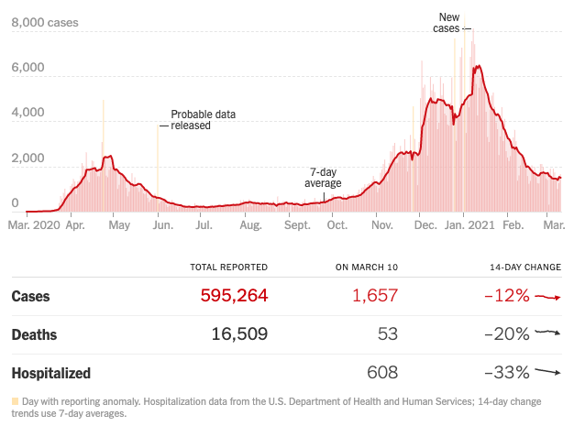

Slide 3
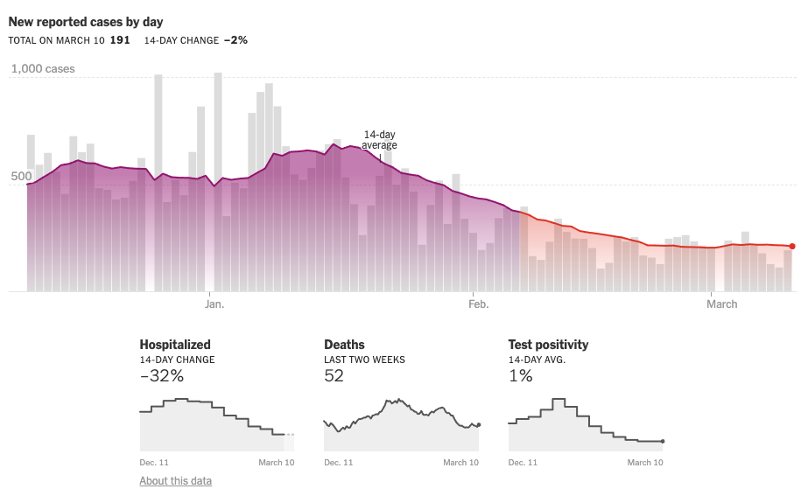

Slide 4
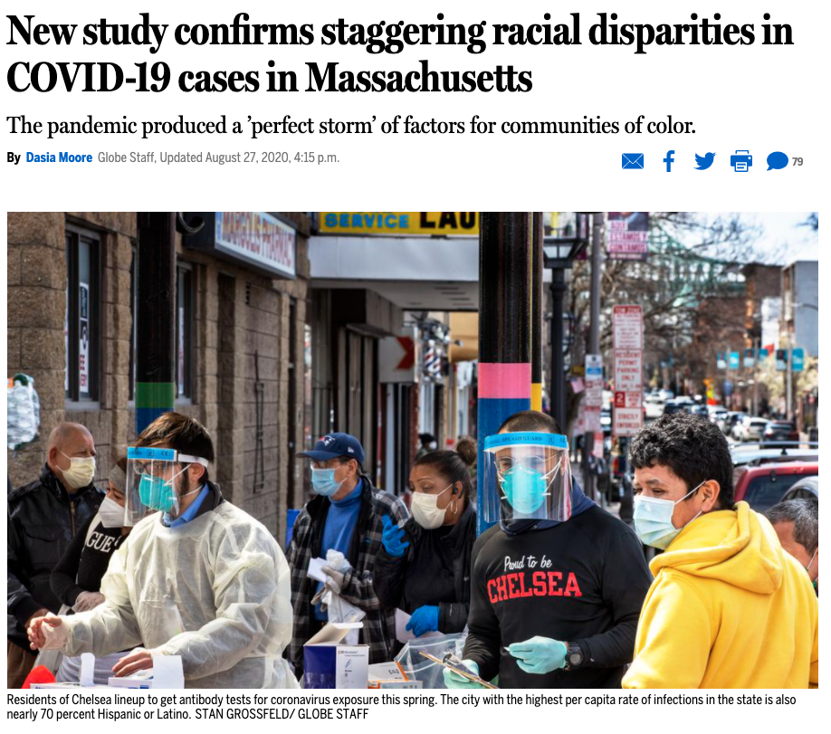

Slide 5
“The COVID-19 virus is ruthlessly contagious and, at the same time, highly selective. It’s capacity to infect is universal, but the consequences of becoming infected are not.” Shonkoff and Williams, 2020

Slide 6
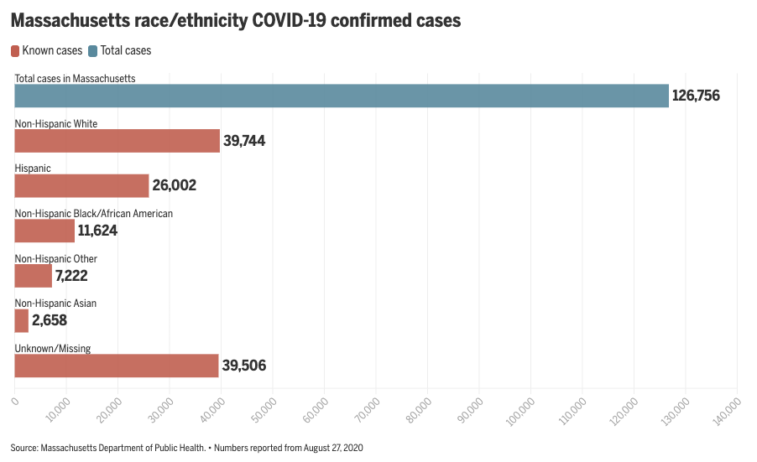
“From the early days of the pandemic, Massachusetts cities with large Latino and Black populations have suffered high infection rates and death tolls.”

Slide 7
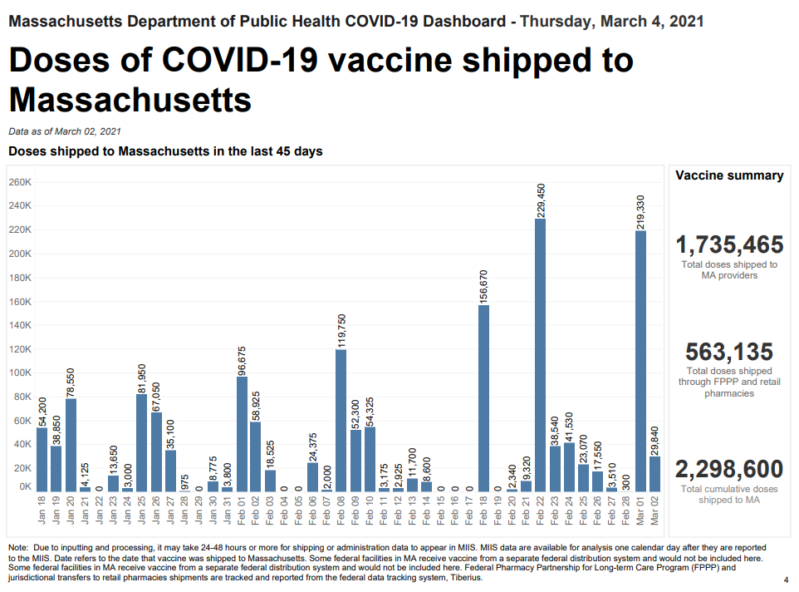

Slide 10
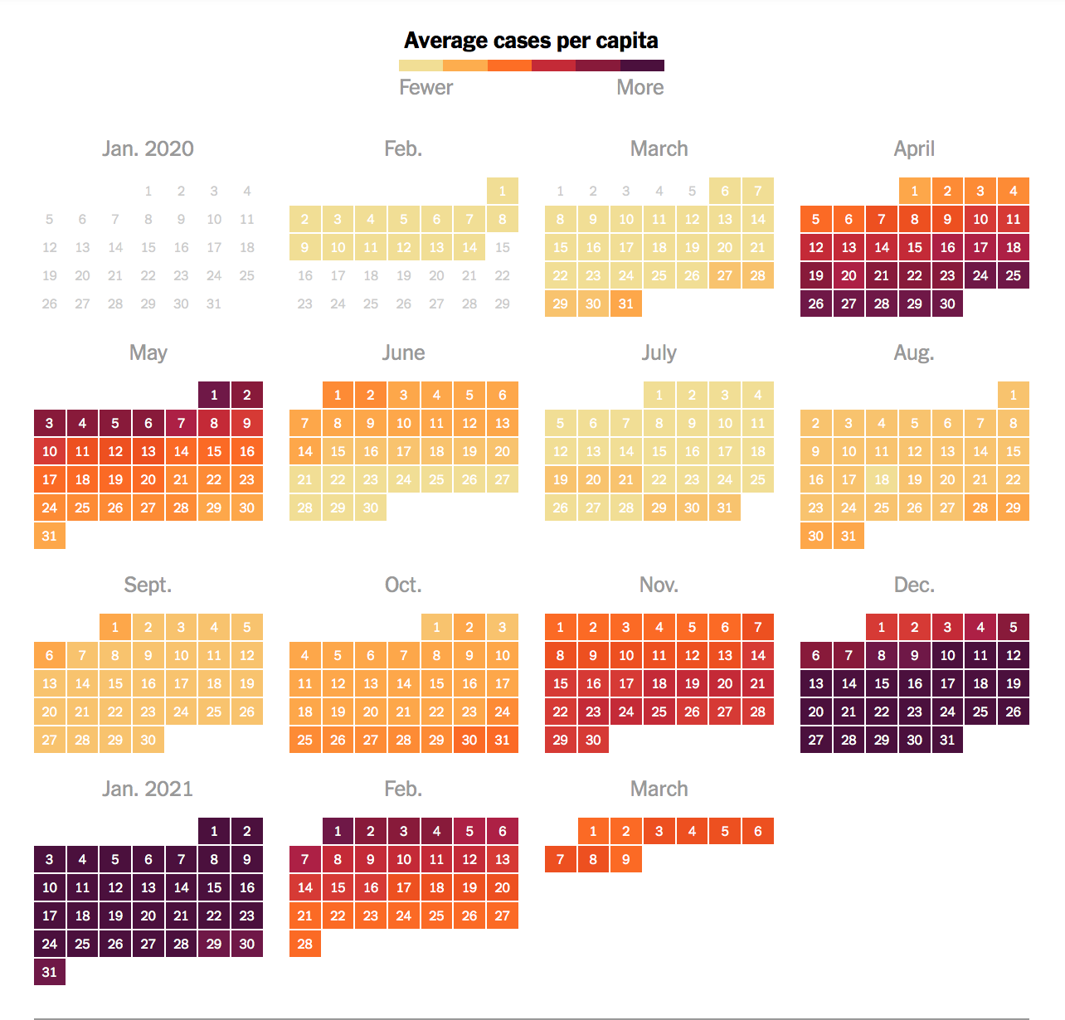
Notes:
https://www.nytimes.com/interactive/2021/us/suffolk-massachusetts-covid-cases.html
Early educators have been on the front lines, providing care and support for young children and families, regardless of how high the average cases per capita have been.

Slide 11
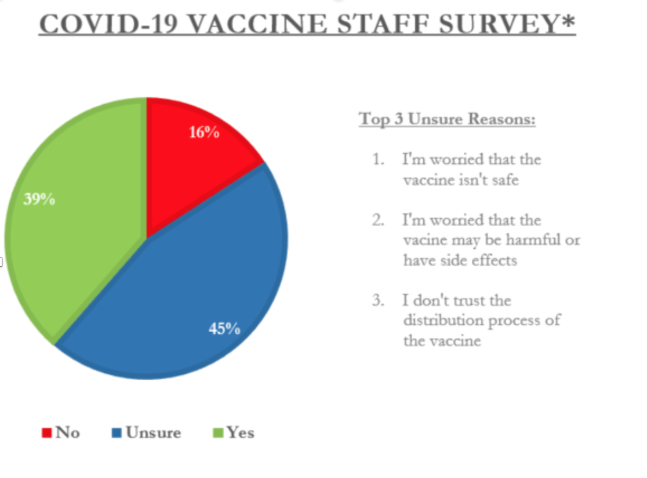

Slide 12
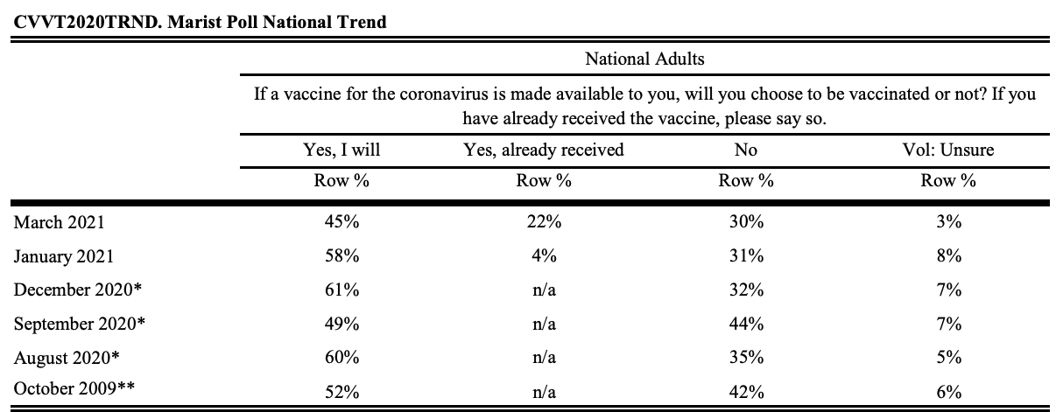
45% of adults want to get the vaccine, while 30% do not

Slide 13
Vaccine Hesitancy
Complex: a mix of fears, historical contexts, life experiences, trauma, peers ; all sources of truth
Need more than health messaging,; more than just ‘understand the science’ or ‘science says so’
Remove Stigma and Shame
Requires Empathy and Humility
How do we have these conversations and how do we support each other?
Rosenbaum, 2/12/21

Slide 14
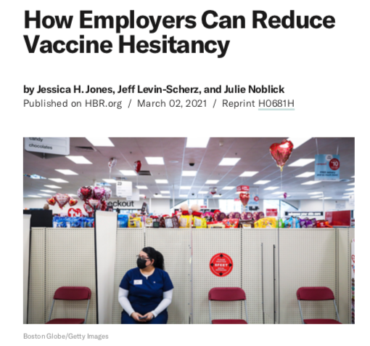
“Social Networks are a powerful tool tool to encourage vaccination."
“For many, the workplace remains one of their most important social networks.”

Slide 15
Dr. Renee Boynton Jarrett, Founding Director, Vital Village
Donna Warner, Child Care Center Director, Boston Children's Hospital
Josette Williams, Program Manager, Countdown to Kindergarten
Natanja Craig-Oquendo, Executive Director, Boston Women's Fund

