Slide 1
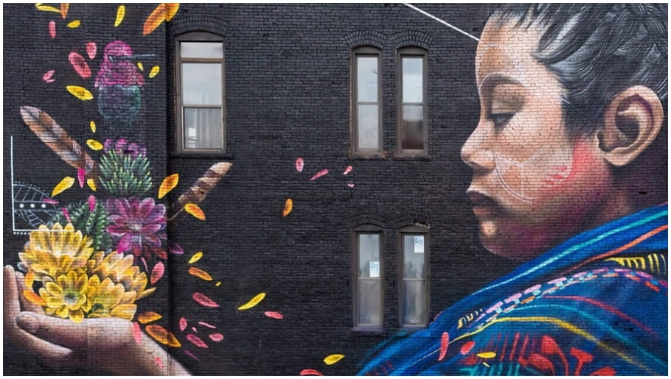
Demographic overview of AAPI communities in Massachusetts
Notes:
Highlight key points:
AAPI are a fast growing, diverse, and large community in Greater Boston
AAPI have faced many challenges during COVID, including experiences of discrimination, unempllyment and small business closures
Looking forward, there are also broader unmet needs for AAPI communities

Slide 2
Net population change, Greater Boston, 1990-2019
Greater Boston’s population growth has been driven by immigrants of color.
Note: “Other” includes “two or more races,” which was not an option in 1990, and “Some Other Race Alone.”
Source: 1990 U.S. Census. 2019 1-year American Community Survey. Native American estimate should be interpreted with caution due to small sample size.
Notes:
SLIDE 2
Boston’s population has changed dramatically in the last 30 years
Driven by immigrants of color

Slide 3
One in 10 Bostonians are Asian American.
Asian pop. in GB similar in size to African American and Latinx pops.
Source: 2019 1-year American Community Survey.
Notes:
TRANSITION: Boston is now a majority POC city
Asian Americans are large group in Boston and Greater Boston
1:10 residents in Boston are Asian American
In GB, AAPI share is close to African American and Latinx size
Note: that multiracial folks not included in this graph

Slide 4
Percent change, 1990 - 2019.
Asian Americans are the fastest growing racial group in Greater Boston.
Source: 2019 1-year American Community Survey.
Notes:
TRANSITION: AAPI growth has been fast and recent
Faster than other racial groups in both Boston and GB
Greater growth in suburbs

Slide 5
More than two-thirds of Asian Americans are foreign born, higher than any other racial group. Share foreign born. Greater Boston.
Source: 1990 U.S. Census. 2019 1-year American Community Survey. Native American estimate should be interpreted with caution due to small sample size.
Notes:
TRANSITION: A lot of this growth is due to immigration
Large share of AAPI and Latinx are foreign-born
Surprisingly that’s even more true for AAPI community
Diversity of immigrant share

Slide 6
Asian American immigrants come to the U.S. through a wide range of channels. People obtaining lawful permanent residency. Sample Asian countries of origin. 2018.
Source: DHS 2018 Yearbook of Immigration Statistics.
Notes:
TRANSITION: One way to understand diversity of Asian American immigrants is pathway for obtaining permanent residency
Explain different categories
Difference between entering as highly-skilled worker vs. refugee
Emphasize impacts that this has on needs

Slide 7
Almost 1/4 of unauthorized immigrants in Massachusetts are Asian.
Mexico and Central America
South America
Source: Migration Policy Institute, Profile of Unauthorized Population: Massachusetts, 2019
Notes:
TRANSITION: Another way that AAPI differ is immigration status
Estimated 39,000 unauthorized immigrants from Asia in Massachusetts
Impact this has on service access and provision, this was particularly clear during COVID-19

Slide 8
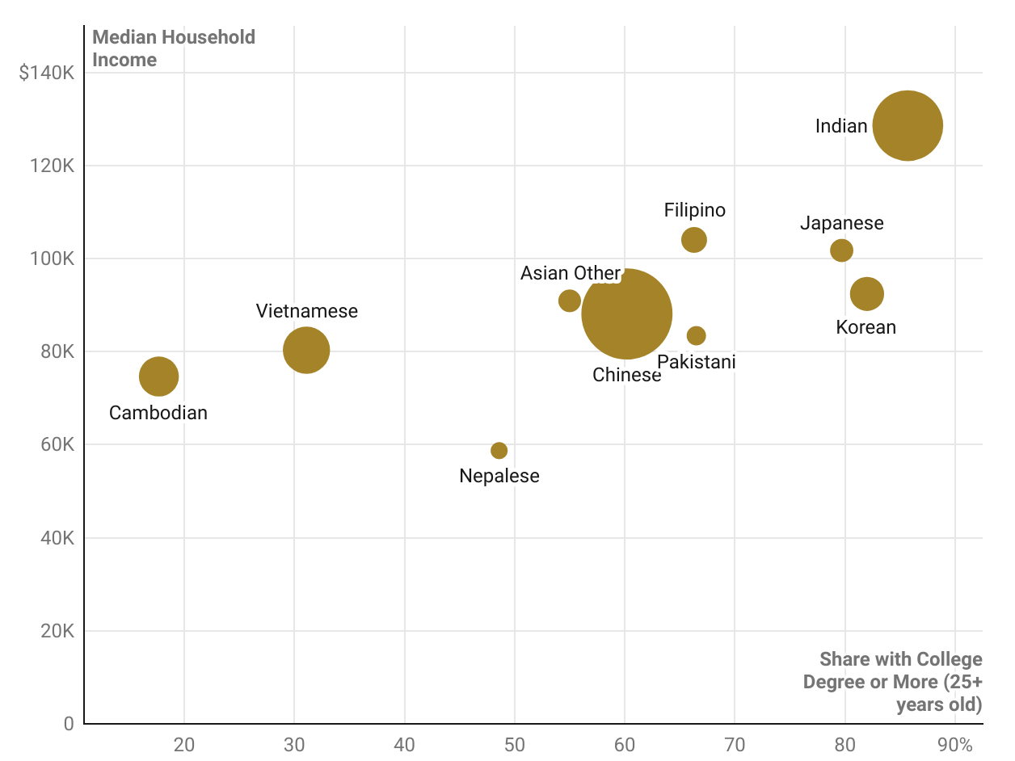
Income and educational attainment vary greatly across AAPI communities. Top 10 countries of ancestry for Asian Americans in Greater Boston. 2018.
Median Household Income
Source: 2014-2018 American Community Survey
Share with College Degree or More (25+ years old)
Notes:
TRANSITION: To summarize, there is tremendous diversity that is often masked when numbers are aggregated
According to a McKinsey study, Asian Americans have the largest intra-racial income inequality of any racial group.
Because of this aggregate average, $102,875 is much higher than it is for some groups → need to disaggregate

Slide 9
AAPI challenges during COVID-19 pandemic

Slide 10
8 out of 10 Asian Americans say that violence against them is increasing. Survey of US adults conducted April 5-11, 2021, by Pew Research Center.
% of Asian adults who say violence against Asian Americans in the U.S. is…
Notes:
TRANSITION: Doesn’t seem to be slowing down-
80% of AAPI say incidents are increasing
Emphasize that there is a history of discrimination of AAPI, that has gained more public attention during crisis
Could mention JA internment, Vincent Chin, Muslims post-9/11

Slide 11
Almost half of Asian Americans experienced an incident of hate because of their racial or ethnic background since the pandemic began. Survey of US adults conducted April 5-11, 2021, by Pew Research Center.
Notes:
TRANSITION: Beyond reported incidents, survey data has found that an alarming number of AAPI experience of hate since the pandemic began
However, this is not an abnormally high number, it is actually lower than previous years – gained more public attention during crisis
Survey was conducted exclusively in English, so we’d expect this number to be higher since many individuals reported they were targeted because of the language they spoke
Translating surveys is important for all languages, but particularly true for Asian Americans because of language diversity

Slide 12
Nationally, over 6,000 reports of anti-Asian hate have been reported. National incidents reported to Stop AAPI Hate. March 2020 - March 2021.

Slide 13
1:5 Stop AAPI Hate respondents now display signs of racial trauma.
Notes:
TRANSITION: this has an impact on AAPI mental health and wellbeing
Hallmarks of racial trauma = shunning, avoidance, anxiety

Slide 14
Asian entrepreneurs are more likely to be in hard-hit industries that have closed at high rates. Share of MA entrepreneurs that are AAPI by sector. 2019.
6.6 Percentage of AAPI in Massachusetts
Source: 2015-2019 American Community Survey Public Use Microdata Sample
Notes:
TRANSITION: Economic impacts
AAPI over represented in sectors that have been hard hit
According to Opportunity Insights, the number of small businesses in Masssachusetts had decreased by ~40% by May 2021, while 60% of Leisure & Hospitality businsses had shut down,

Slide 15
Asian-owned businesses saw steep revenue declines during the pandemic. Small Businesses that experienced severe revenue declines (>75%). National. 2019 vs. 2020.
Source Economic impact of pandemic on 8,328 US small businesses; Reimagine Main Street & Public Private Strategies’ Business Owners of Color COViD-19 Survey
Notes:
TRANSITION: translated to real losses
BECAUSE concentration in hard hit sectors + racism
And need for aid
And trouble receiving it
Continued in Pandemic --- inadequate language services, complicated systems, lack of an existing relationship with an established bank

Slide 16
AAPI work in a range of occupations, many of which cannot be performed from home.
Occupational make up of workers by ancestry. MA. 2019.
Source: 2015-2019 American Community Survey Public Use Microdata Sample
Notes:
TRANSITION: also challenges for workers:
This is a lot to digest → we’ll share slides lter
Many can’t work from home
Filipin@s are overrepresented in healthcare.

Slide 17
Broader unmet needs for AAPI communities in Massachusetts
Notes:
TRANSITION: looking back to look forward – unmet needs to address in a just & equitable recovery → builds on early two sections
This isn’t everything ,just some that we have dat on

Slide 18
Poverty

Slide 19
Asian poverty is 2x White poverty in Greater Boston and 3x White poverty in Boston. Poverty rates by race/ethnicity: Boston vs. Greater Boston. 2019.
Source: 2015-2019 American Community Survey 5-year Estimates.
Notes:
Poverty high for AAPI compared to white
Similar to other POC groups
High in both suburbs and greater boston, but particularly Boston

Slide 20
Some Asian renters are more housing cost-burdened than others. Share of renters that are housing cost burdened by ethnicity. Massachusetts. 2017.
Source: National Equity Atlas
Notes:
TRANSITION: important to note how these aggregate categories obscure wide disparities within AAPI label – see this in housing cost burdened
Aggregate similar to white, lower than black and latinx
Disaggregated see that some communities are similar to black/latinx

Slide 21
Language Access

Slide 22
English proficiency varies widely across Asian communities. Percent of speakers that speak English “less than very well,” Asian languages spoken at home with 7,500+ speakers in MA.
Source: 2014-2018 American Community Survey 5-year Estimates; Table B16001
Notes:
TRANSITION: there is a need for resources and services – one barrier to accessing them is language access
Challenges that arise with limited English proficiency + limited language access:
Accessing services
Hard to survey any group but particularly hard because of diversity of AAPI languages means that data is even more biased towards not capturing AAPI poverty
E.g. Karen or Kachin speakers in Oaklan

Slide 23
Many AAPI households are linguistically isolated, particularly Vietnamese and Chinese households. Percent of speakers that are linguistically isolated (no one in household over the age of 14 speaks English exclusively or “very well). MA 2019.
Source: 2015-2019 American Community Survey; IPUMS USA
Notes:
TRANSITION: previous graph looked at individual language access, this graph looks at households
Emphasize how this impacts access to public resources
Note that you could still have a school-age child who speaks English and be considered a ”linguistically isolated household”→ part of Asian American experience for many is translating for older generations

Slide 24
Political Power and Civic Voice
Notes:
TRANSITION: We know that AAPI are a fast growing, diverse and large share of Greater Boston’s population and we want to close on how that translates to political power and civic voice
Don’t have uniform data, just showing a few places where we found compelling data

Slide 25
Many teaching forces are not representative of their AAPI students. Student and full-time equivalent teacher shares, MA schools with largest number of AAPI student. SY 2020.
Source: MA Department of Elementary and Secondary Education
Notes:
TRANSITION: Municipal workforce has not actually caught up with growth in AAPI pop
Large gaps in school districts serving lots of Asian students
Statewide – only 1.8% of teachers are Asian

Slide 26
Asian and Pacific Islanders are underrepresented in municipal government. MAPC analysis of Metro Boston civilian labor force and municipal employees by race/ethnicity. 2016.
Note: White, API, Black and Other racial groups do not include individuals who identify as Latinx. Latinx can be of any race. Source: 2012-2016 American Community Survey Public Use Microdata Sample
Notes:
TRANSITION: looking at other municipal workers even more stark
These are the individuals responsible for allocating and distributing services → important that those at the table reflect those they serve
In Quincy, approx. 30% of the city’s population is Asian, but only 24 out of the 966 employees are Asian – or 2%.

Slide 27
Less than one percent of municipal managers in Metro Boston are AAPI. MAPC analysis of Metro Boston municipal managers by race/ethnicity (not including education administrators). 2016.
Note: White, API, Black and Other racial groups do not include individuals who identify as Latinx. Latinx can be of any race. Source: 2012-2016 American Community Survey Public Use Microdata Sample
Notes:
Compliment with stories of representation in elected roles in places like Lowell

Slide 28
Asian American voter turnout has steadily grown in MA and there’s room to grow. Percent of eligible voters that voted. MA VoterTable.
Source: Voter file data from Catalist
Notes:
TRANSITION: AAPI fast gowing, how does this translate to political power?/
Graph from MA VoterTable
AAPI voter turnout has steadily grown in MA
If you’re interested in learning more, MA Voter Table is releasing a new report on 6/2

Slide 29
AAPI are underrepresented in the MA state legislature. 2019 MA population by race compared to 2020 state legislator demographics.
Source: 2019 American Community Survey 1-year Estimate and National Conference of State Legislators

Slide 30
Summary
AAPI communities in MA are fast growing and diverse.
Recent, high-profile AAPI experiences of discrimination and violence reflect existing trends and a history of scapegoating during crisis.
AAPI workers and entrepreneurs have faced many COVID-related challenges.
Aggregated data masks many disparities and community needs, including poverty and a need for improved language resources.
AAPI residents are substantially underrepresented in the municipal workforce and state legislature.

