Slide 1
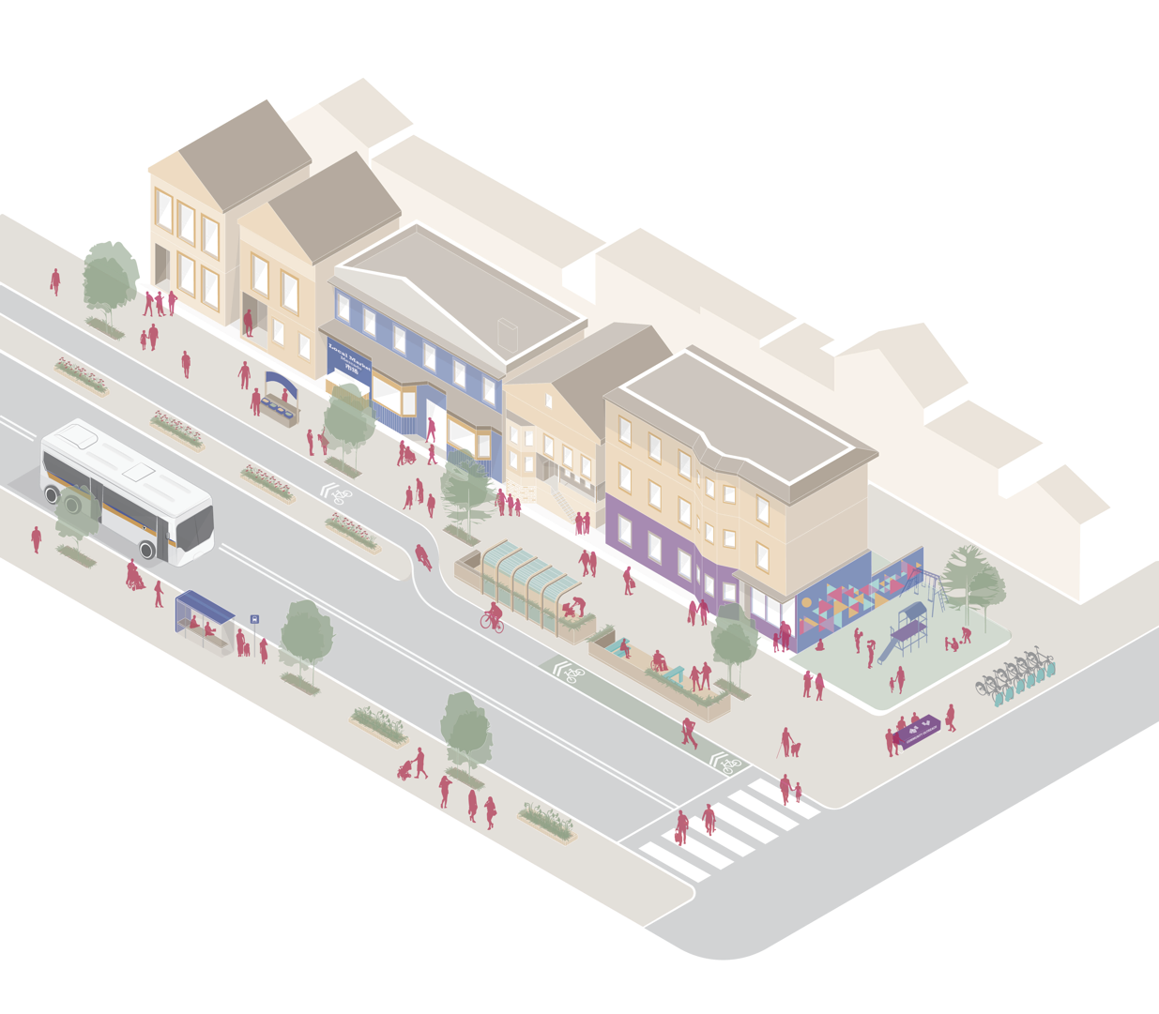
Redesigned streetscapes that include space for walking, biking and gathering

Slide 2
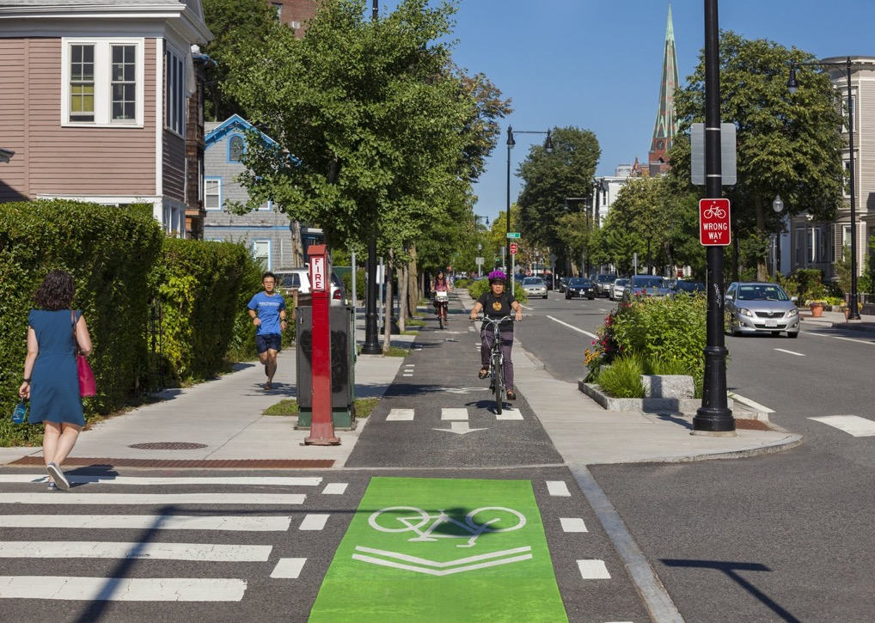
Notes:
Source: City of Cambridge

Slide 3
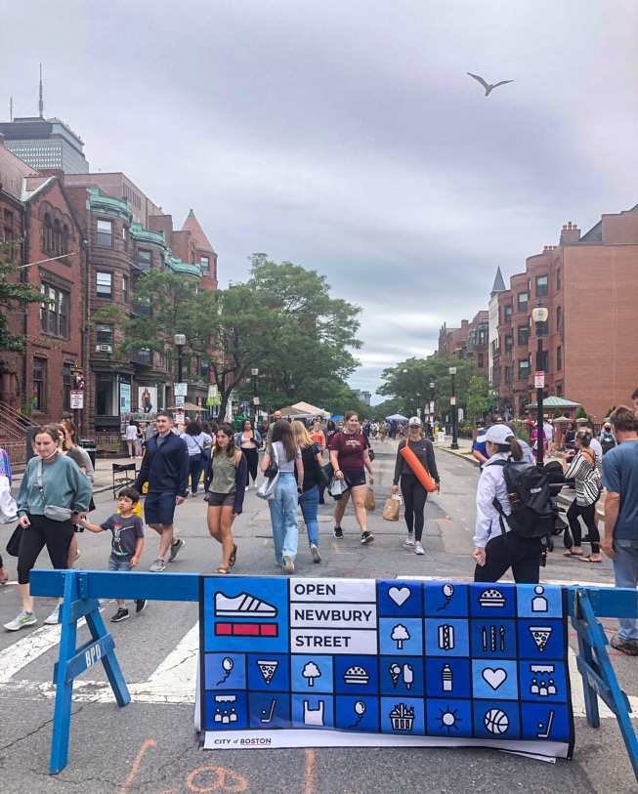
Notes:
Image: https://www.boston.gov/departments/transportation/boston-green-links
https://www.bloomberg.com/news/features/2021-01-05/a-tiny-twist-on-street-design-the-one-minute-city

Slide 4
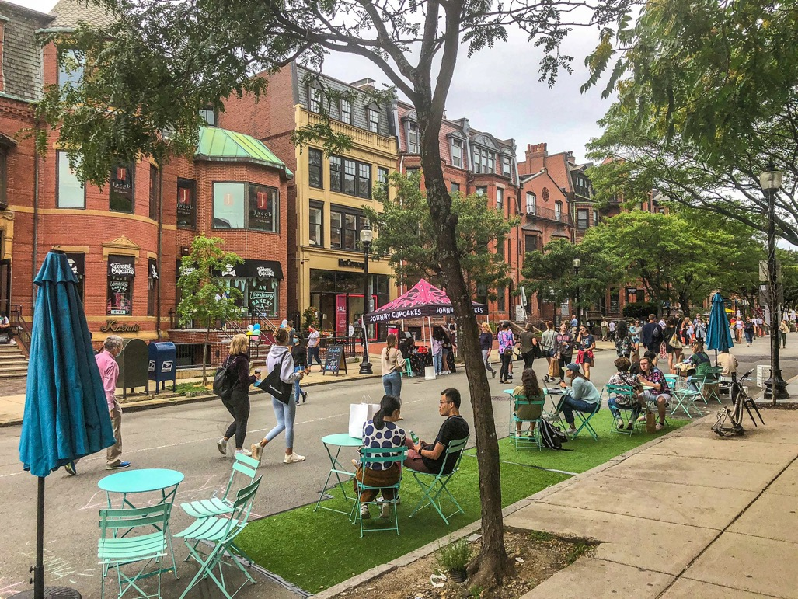
Notes:
Image: https://www.boston.gov/departments/transportation/boston-green-links
https://www.bloomberg.com/news/features/2021-01-05/a-tiny-twist-on-street-design-the-one-minute-city

Slide 5
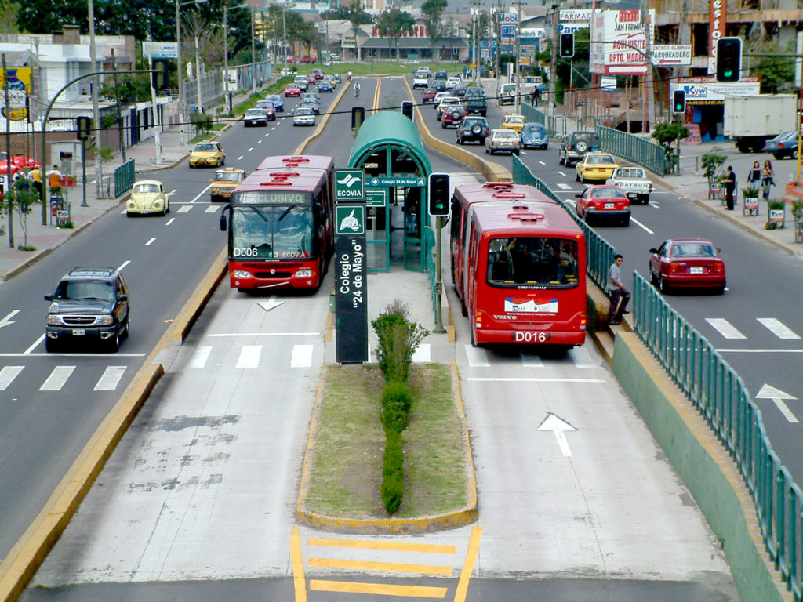
Notes:
Source: ITDP

Slide 6
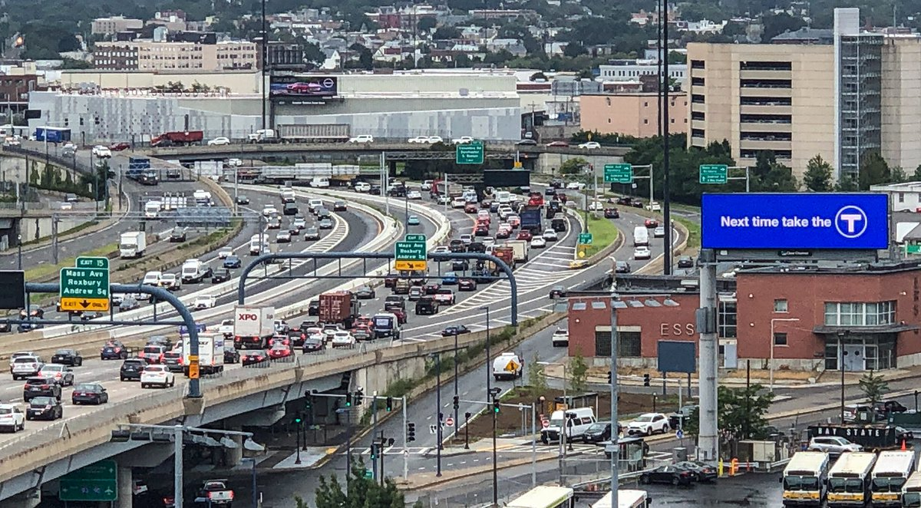
COMPLETE, LIVABLE STREETS: Where are we falling short?
Notes:
Image: https://www.boston.gov/departments/transportation/boston-green-links

Slide 7
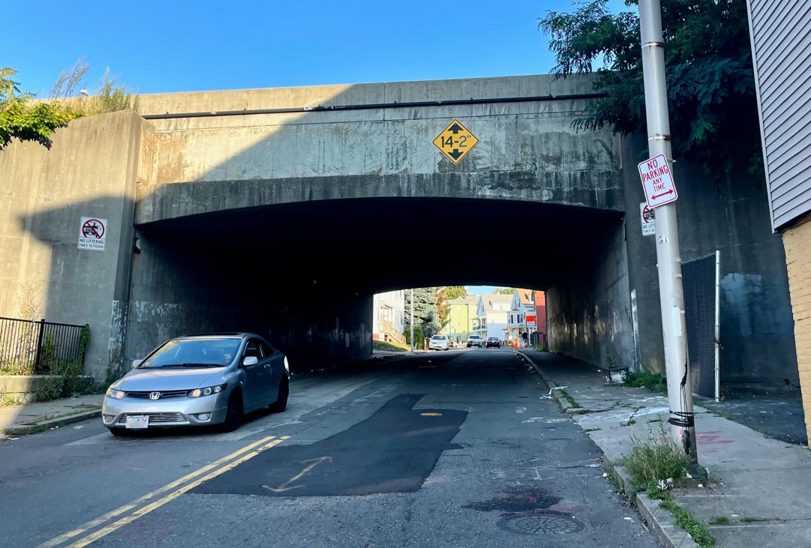
Notes:
Image: https://www.boston.gov/departments/transportation/boston-green-links

Slide 8
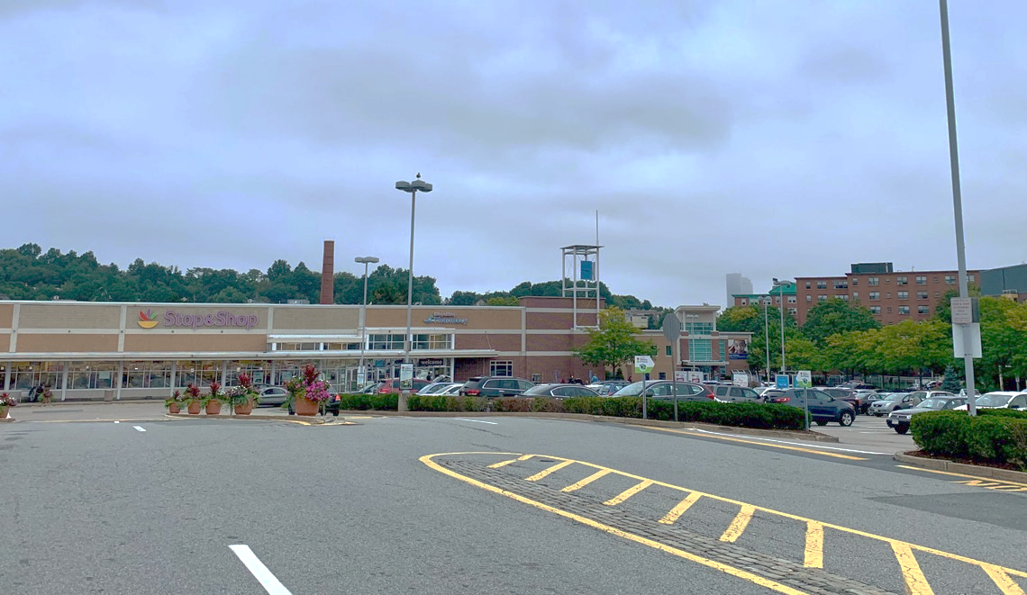
COMPLETE, LIVABLE STREETS: Where are we falling short?
Notes:
Image: https://www.boston.gov/departments/transportation/boston-green-links

Slide 9
Accessible commercial spaces
Redesigned streetscapes that include space for walking, biking and gathering

Slide 10
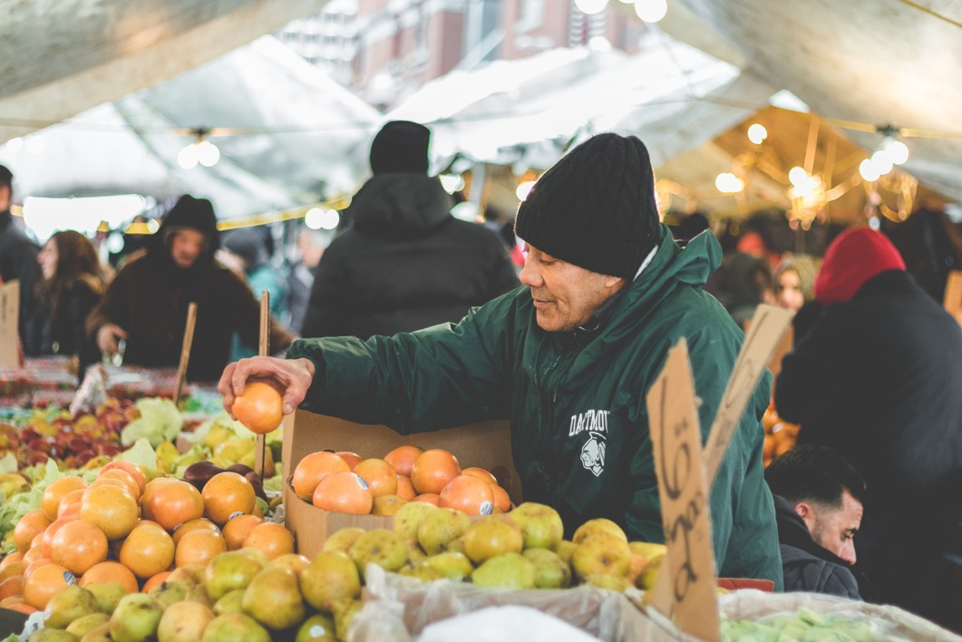
Notes:
Source: Unsplash

Slide 11
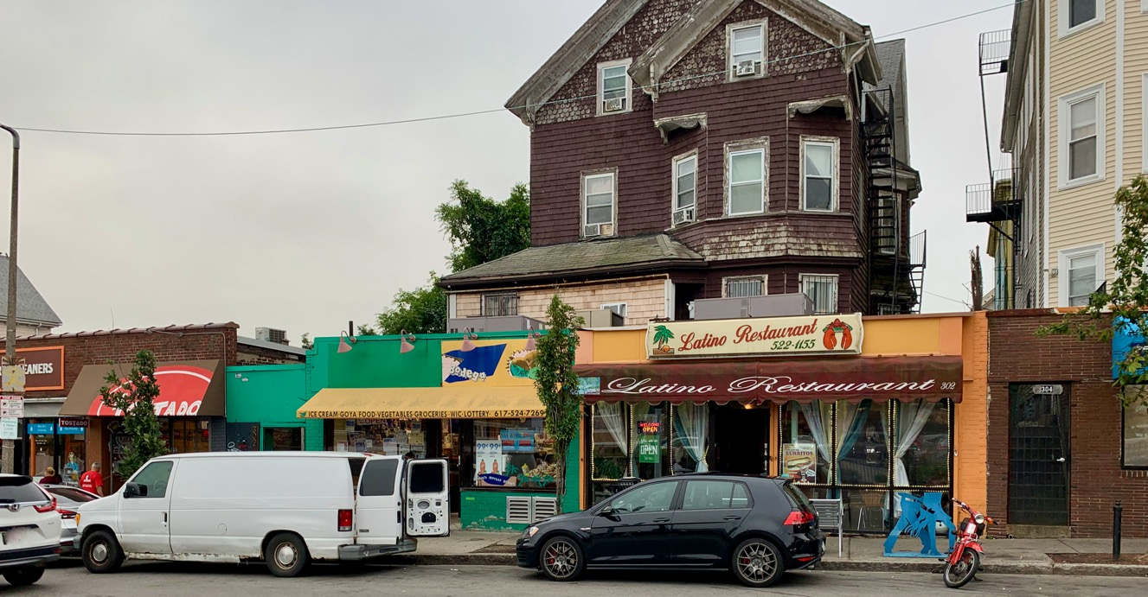

Slide 12
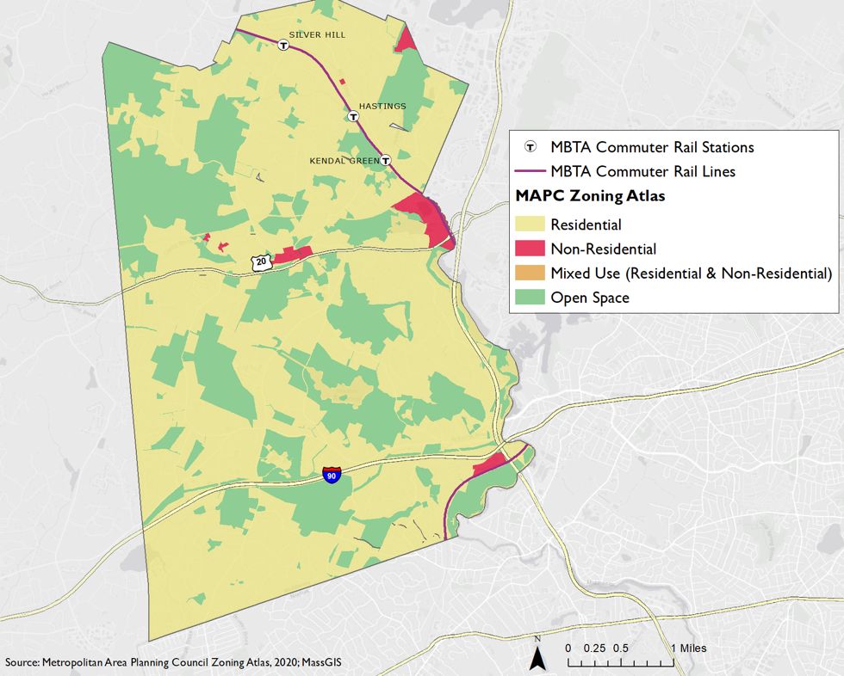

Slide 13
Diverse housing options
Accessible commercial spaces
Redesigned streetscapes that include space for walking, biking and gathering

Slide 14
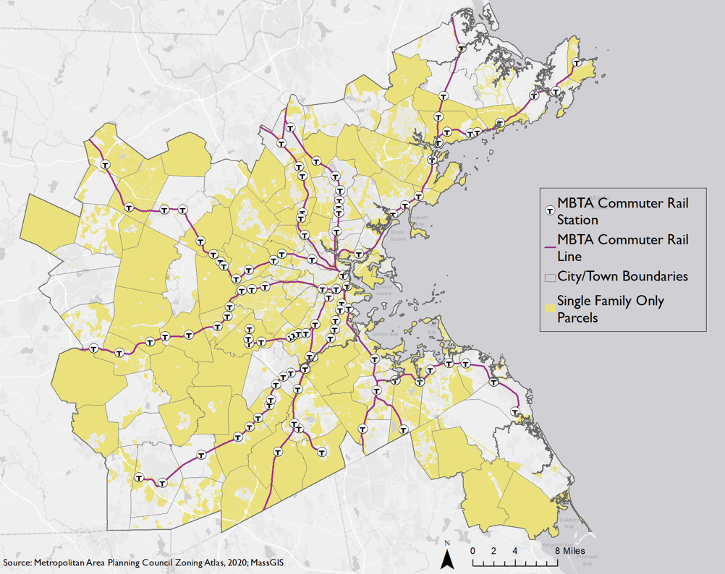

Slide 16
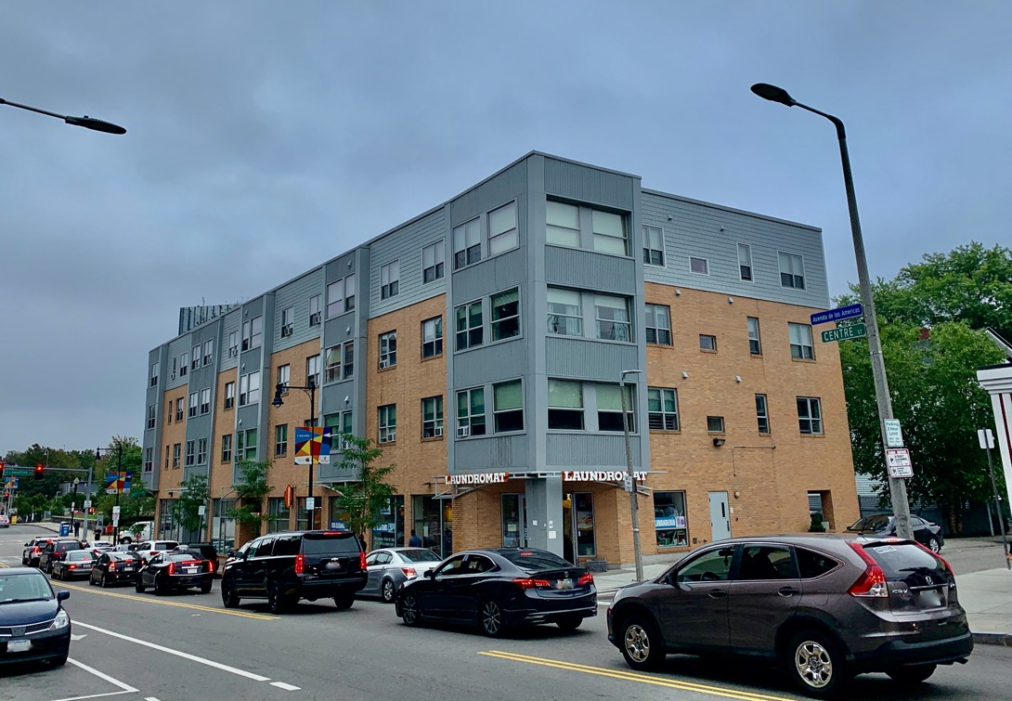

Slide 17
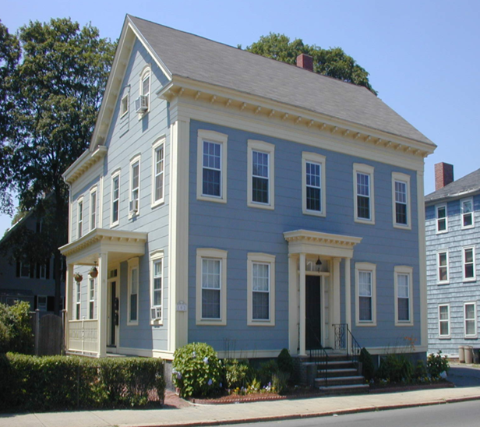
Notes:
Picture Source: City of Salem, MAPC

Slide 18
Diverse housing options
Accessible commercial spaces
Redesigned streetscapes that include space for walking, biking and gathering
Strong social infrastructure

Slide 19
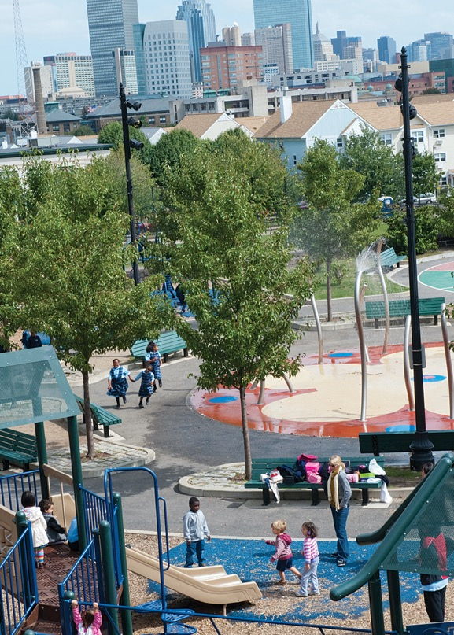

Slide 20
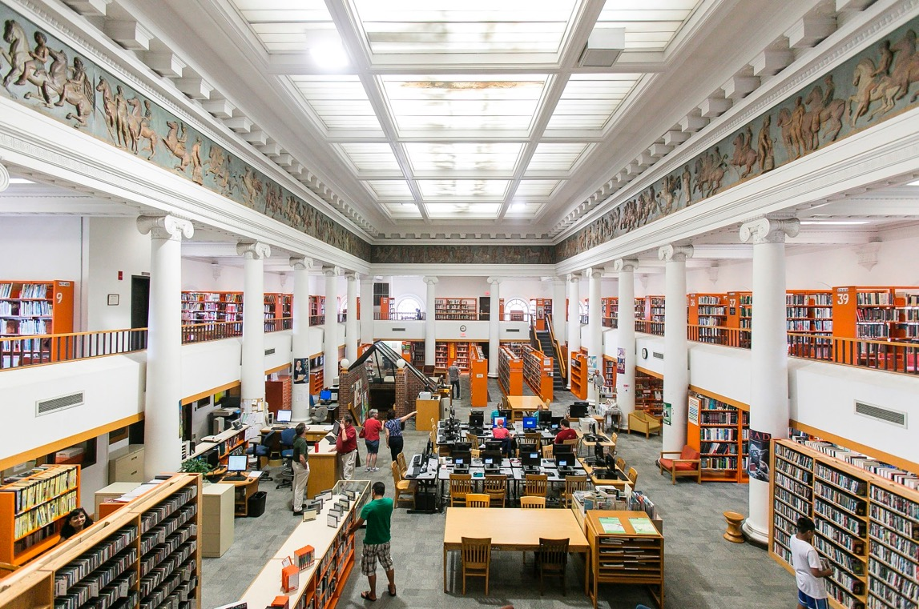
Notes:
Picture Source: Somerville Public Library
https://www.somervillepubliclibrary.org/how-do-i

Slide 21
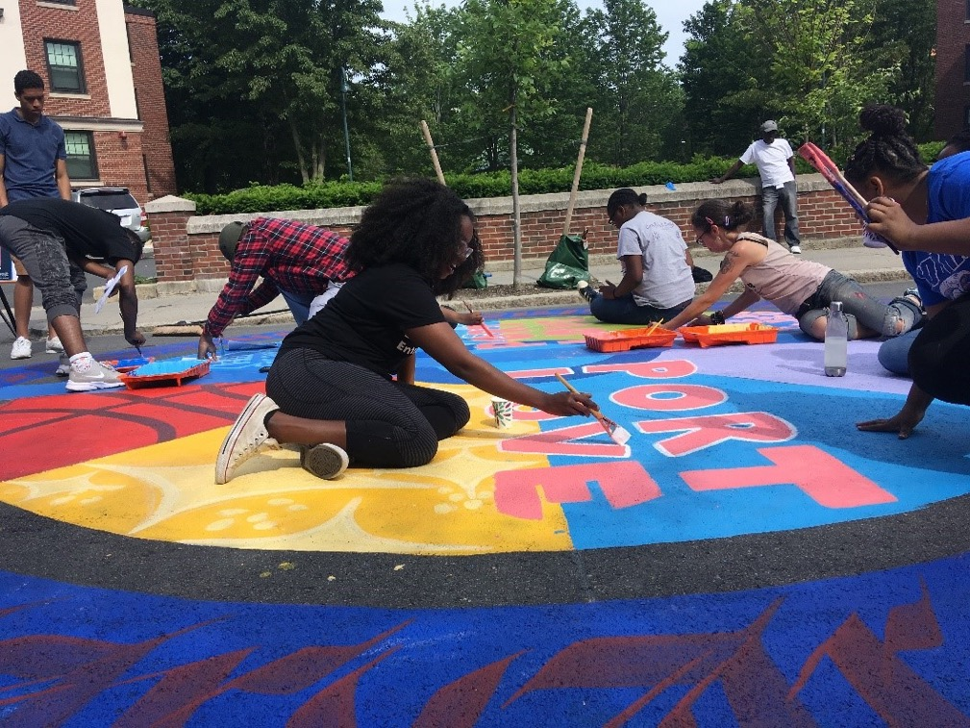

Slide 22
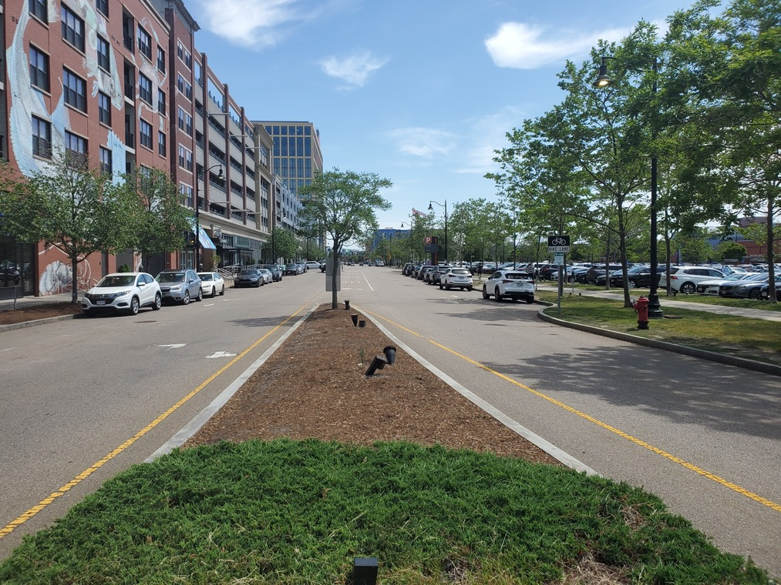

Slide 23
Diverse housing options
Accessible commercial spaces
Diverse and empowered resident population
Redesigned streetscapes that include space for walking, biking and gathering
Strong social infrastructure

Slide 24
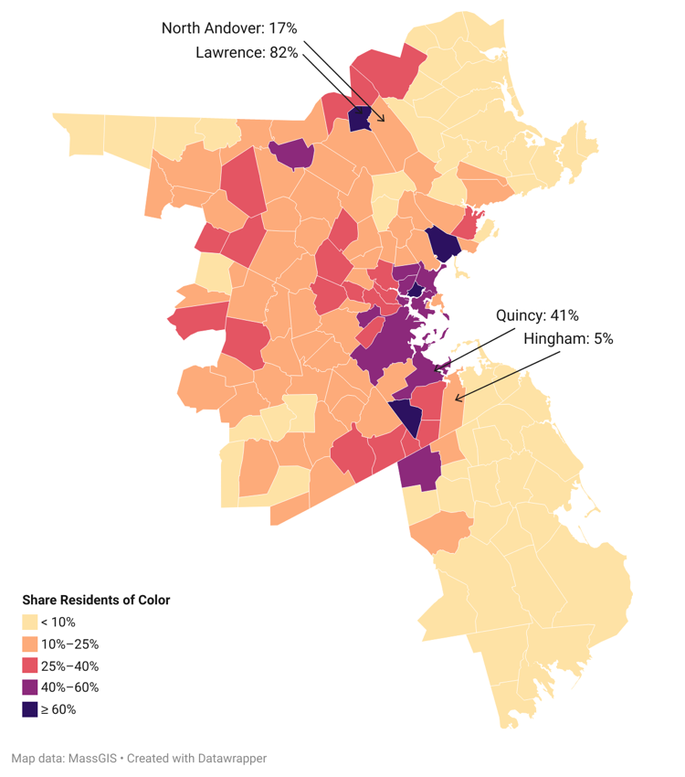
DIVERSE & EMPOWERED RESIDENTS: Where are we falling short?
Source: Census 2020

Slide 25
Diverse housing options
Accessible commercial spaces
Diverse and empowered resident population
Redesigned streetscapes that include space for walking, biking and gathering
Strong social infrastructure

