Slide 1
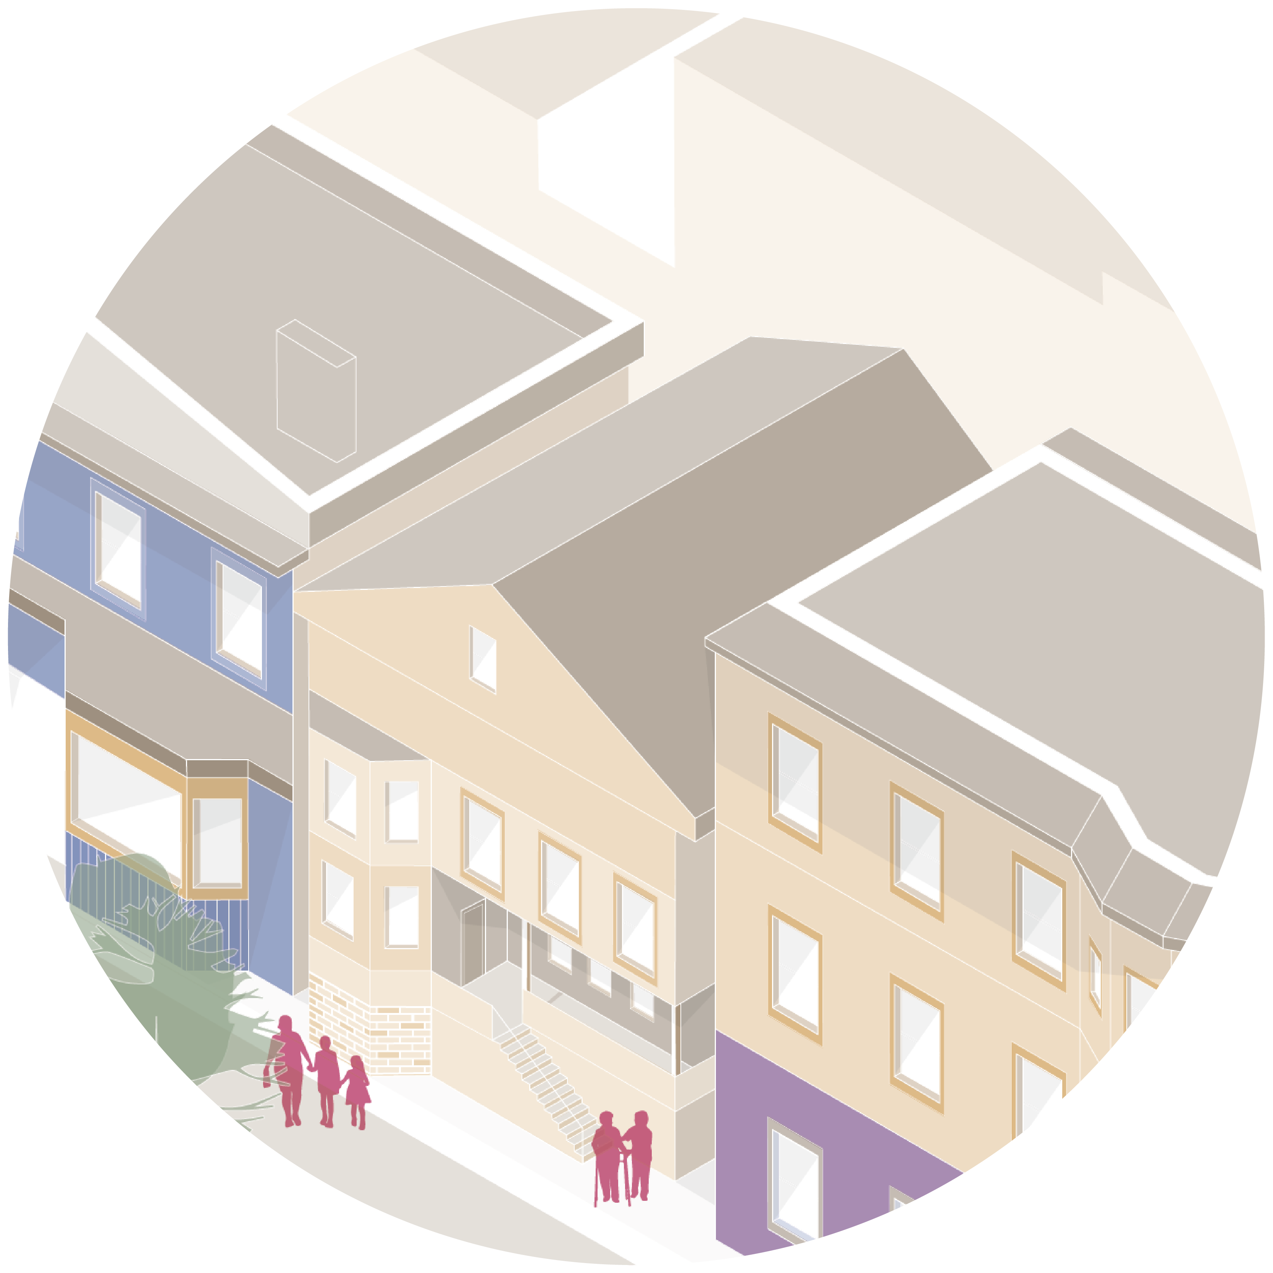
STATE ACTION
STATE ACTION
Legalize multifamily housing by right.
Legalize mixed-use development, especially near existing or planned transit nodes.
Eliminate minimum parking requirements.
Increase the provision of affordable housing.
Strengthen tenant protections.

Slide 2
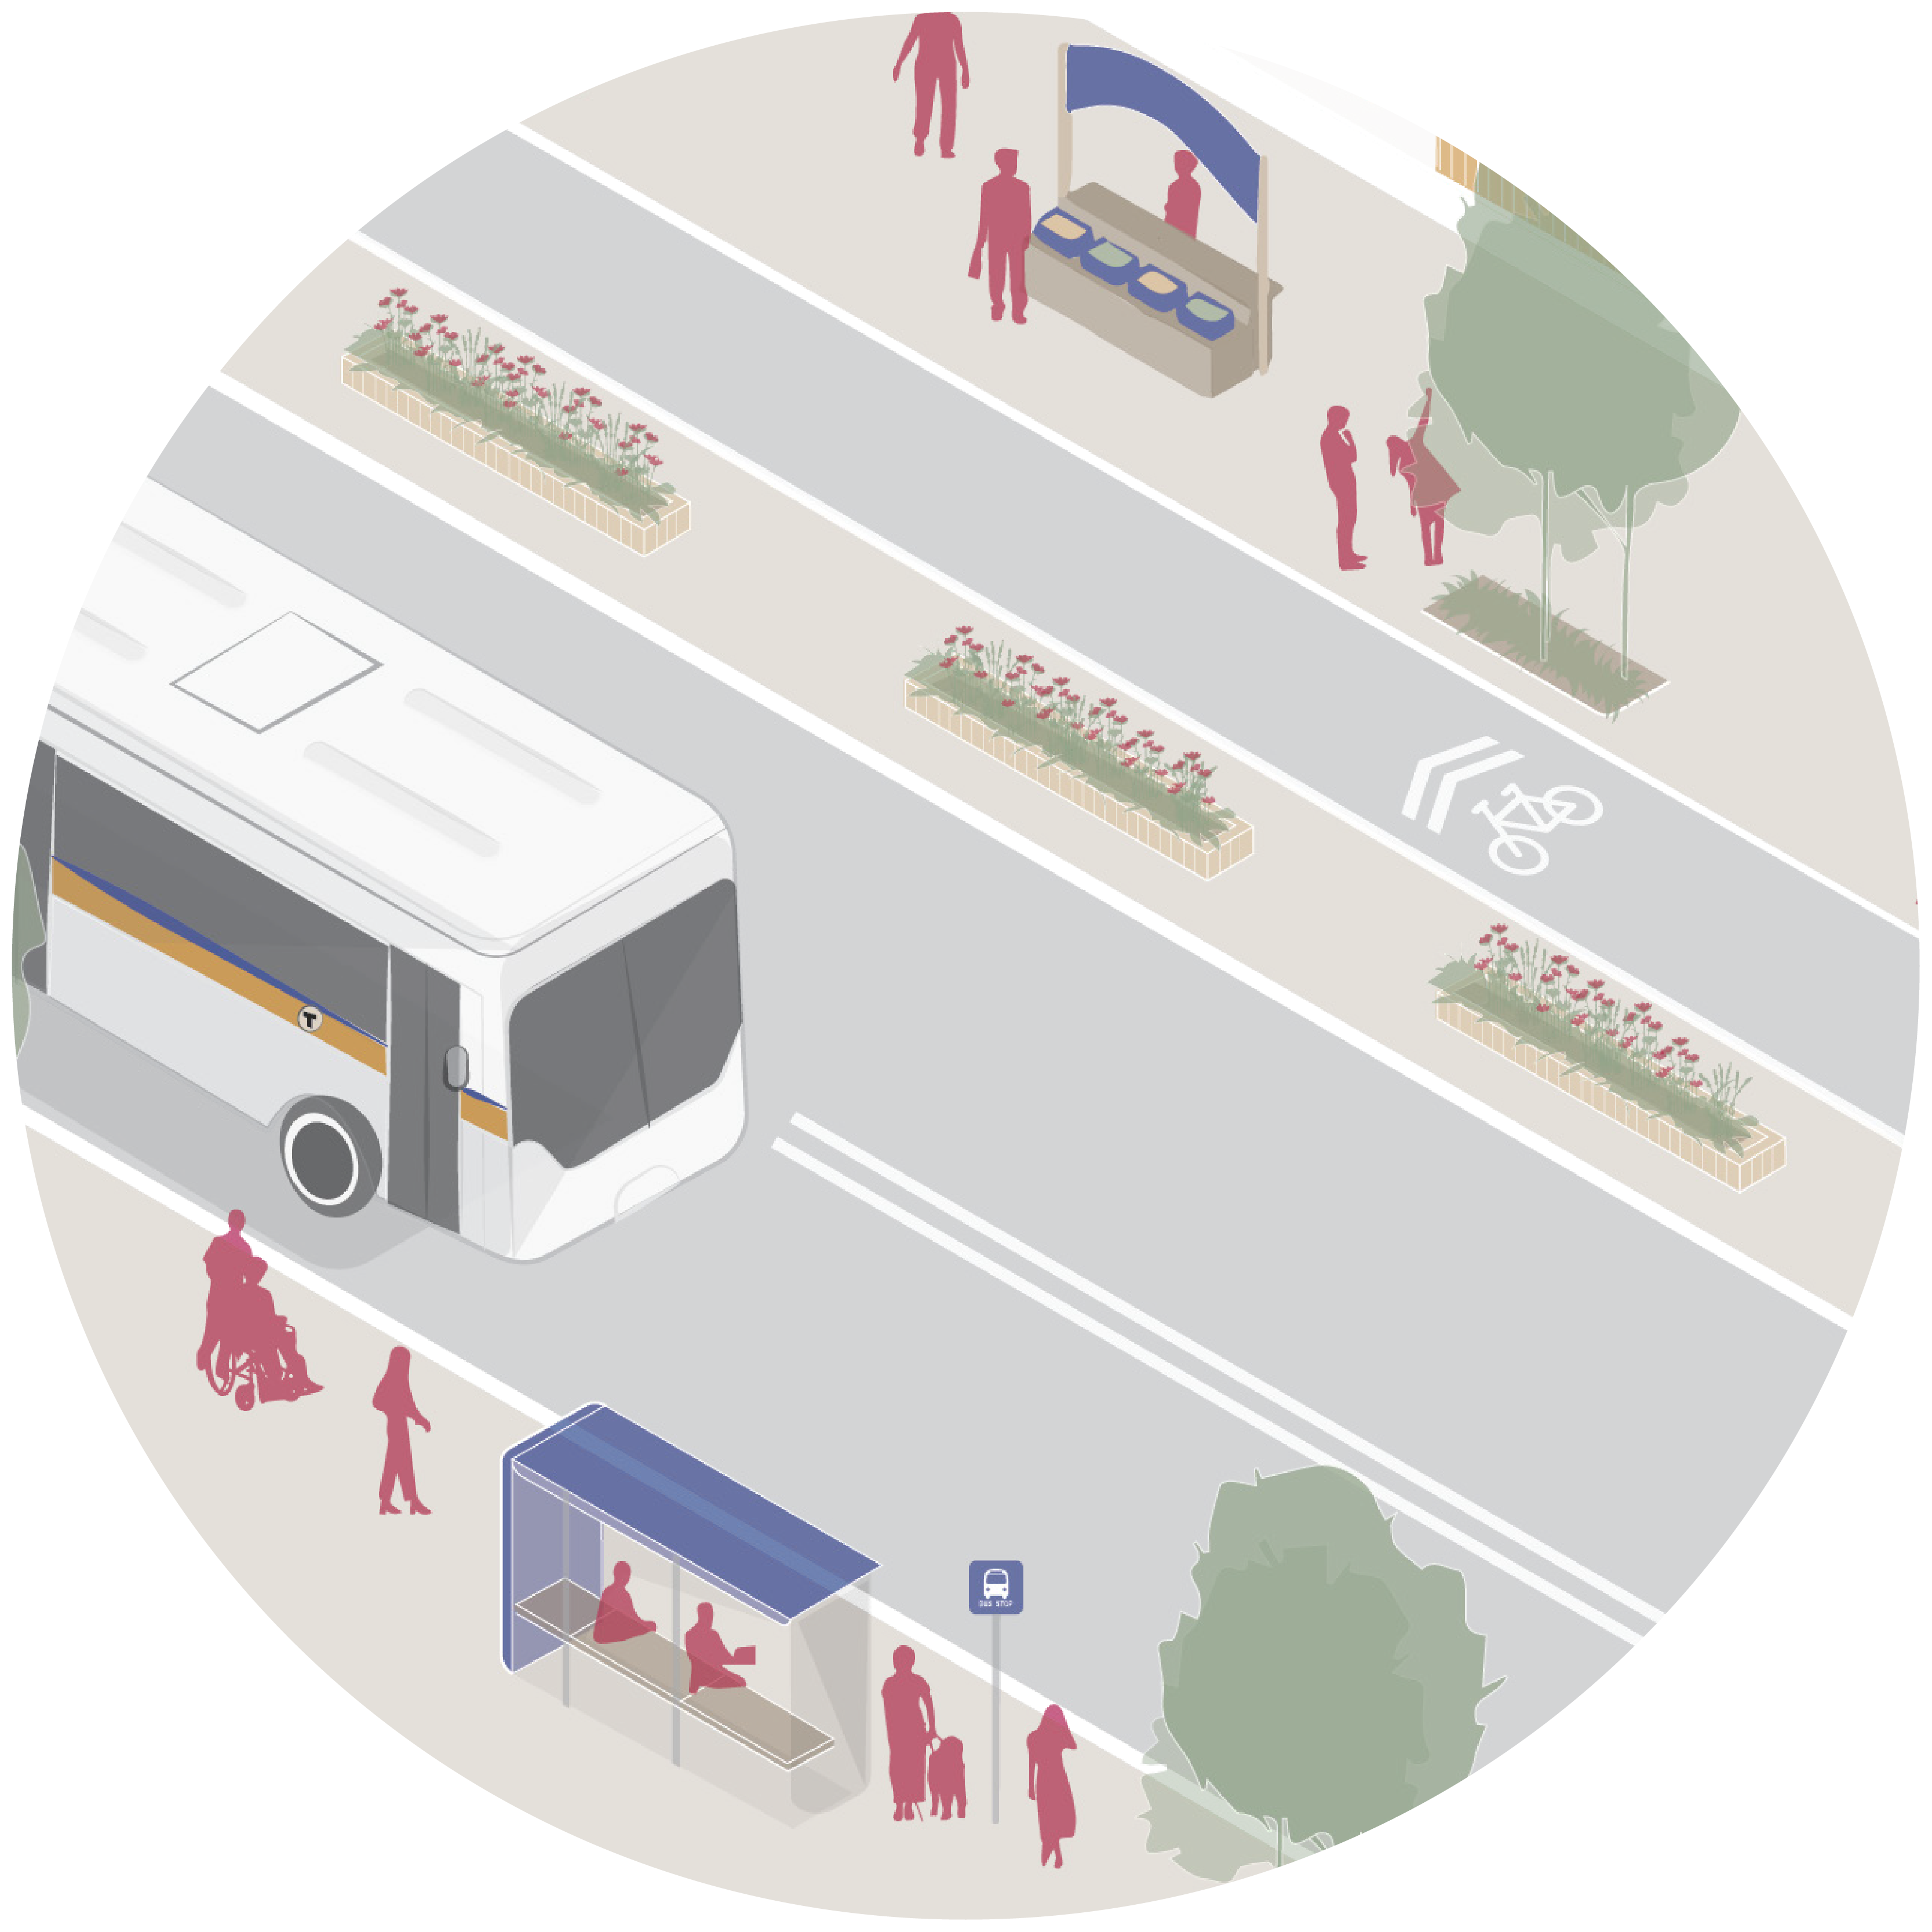
STATE ACTION
STATE ACTION
Better capture the cost of cars.
Invest in local economic development in low-wealth communities.
Increase access to small business loans, particularly for entrepreneurs of color.
Connect neighborhoods with improved public transit and bike networks.
Restart the Office of State Planning.

Slide 3
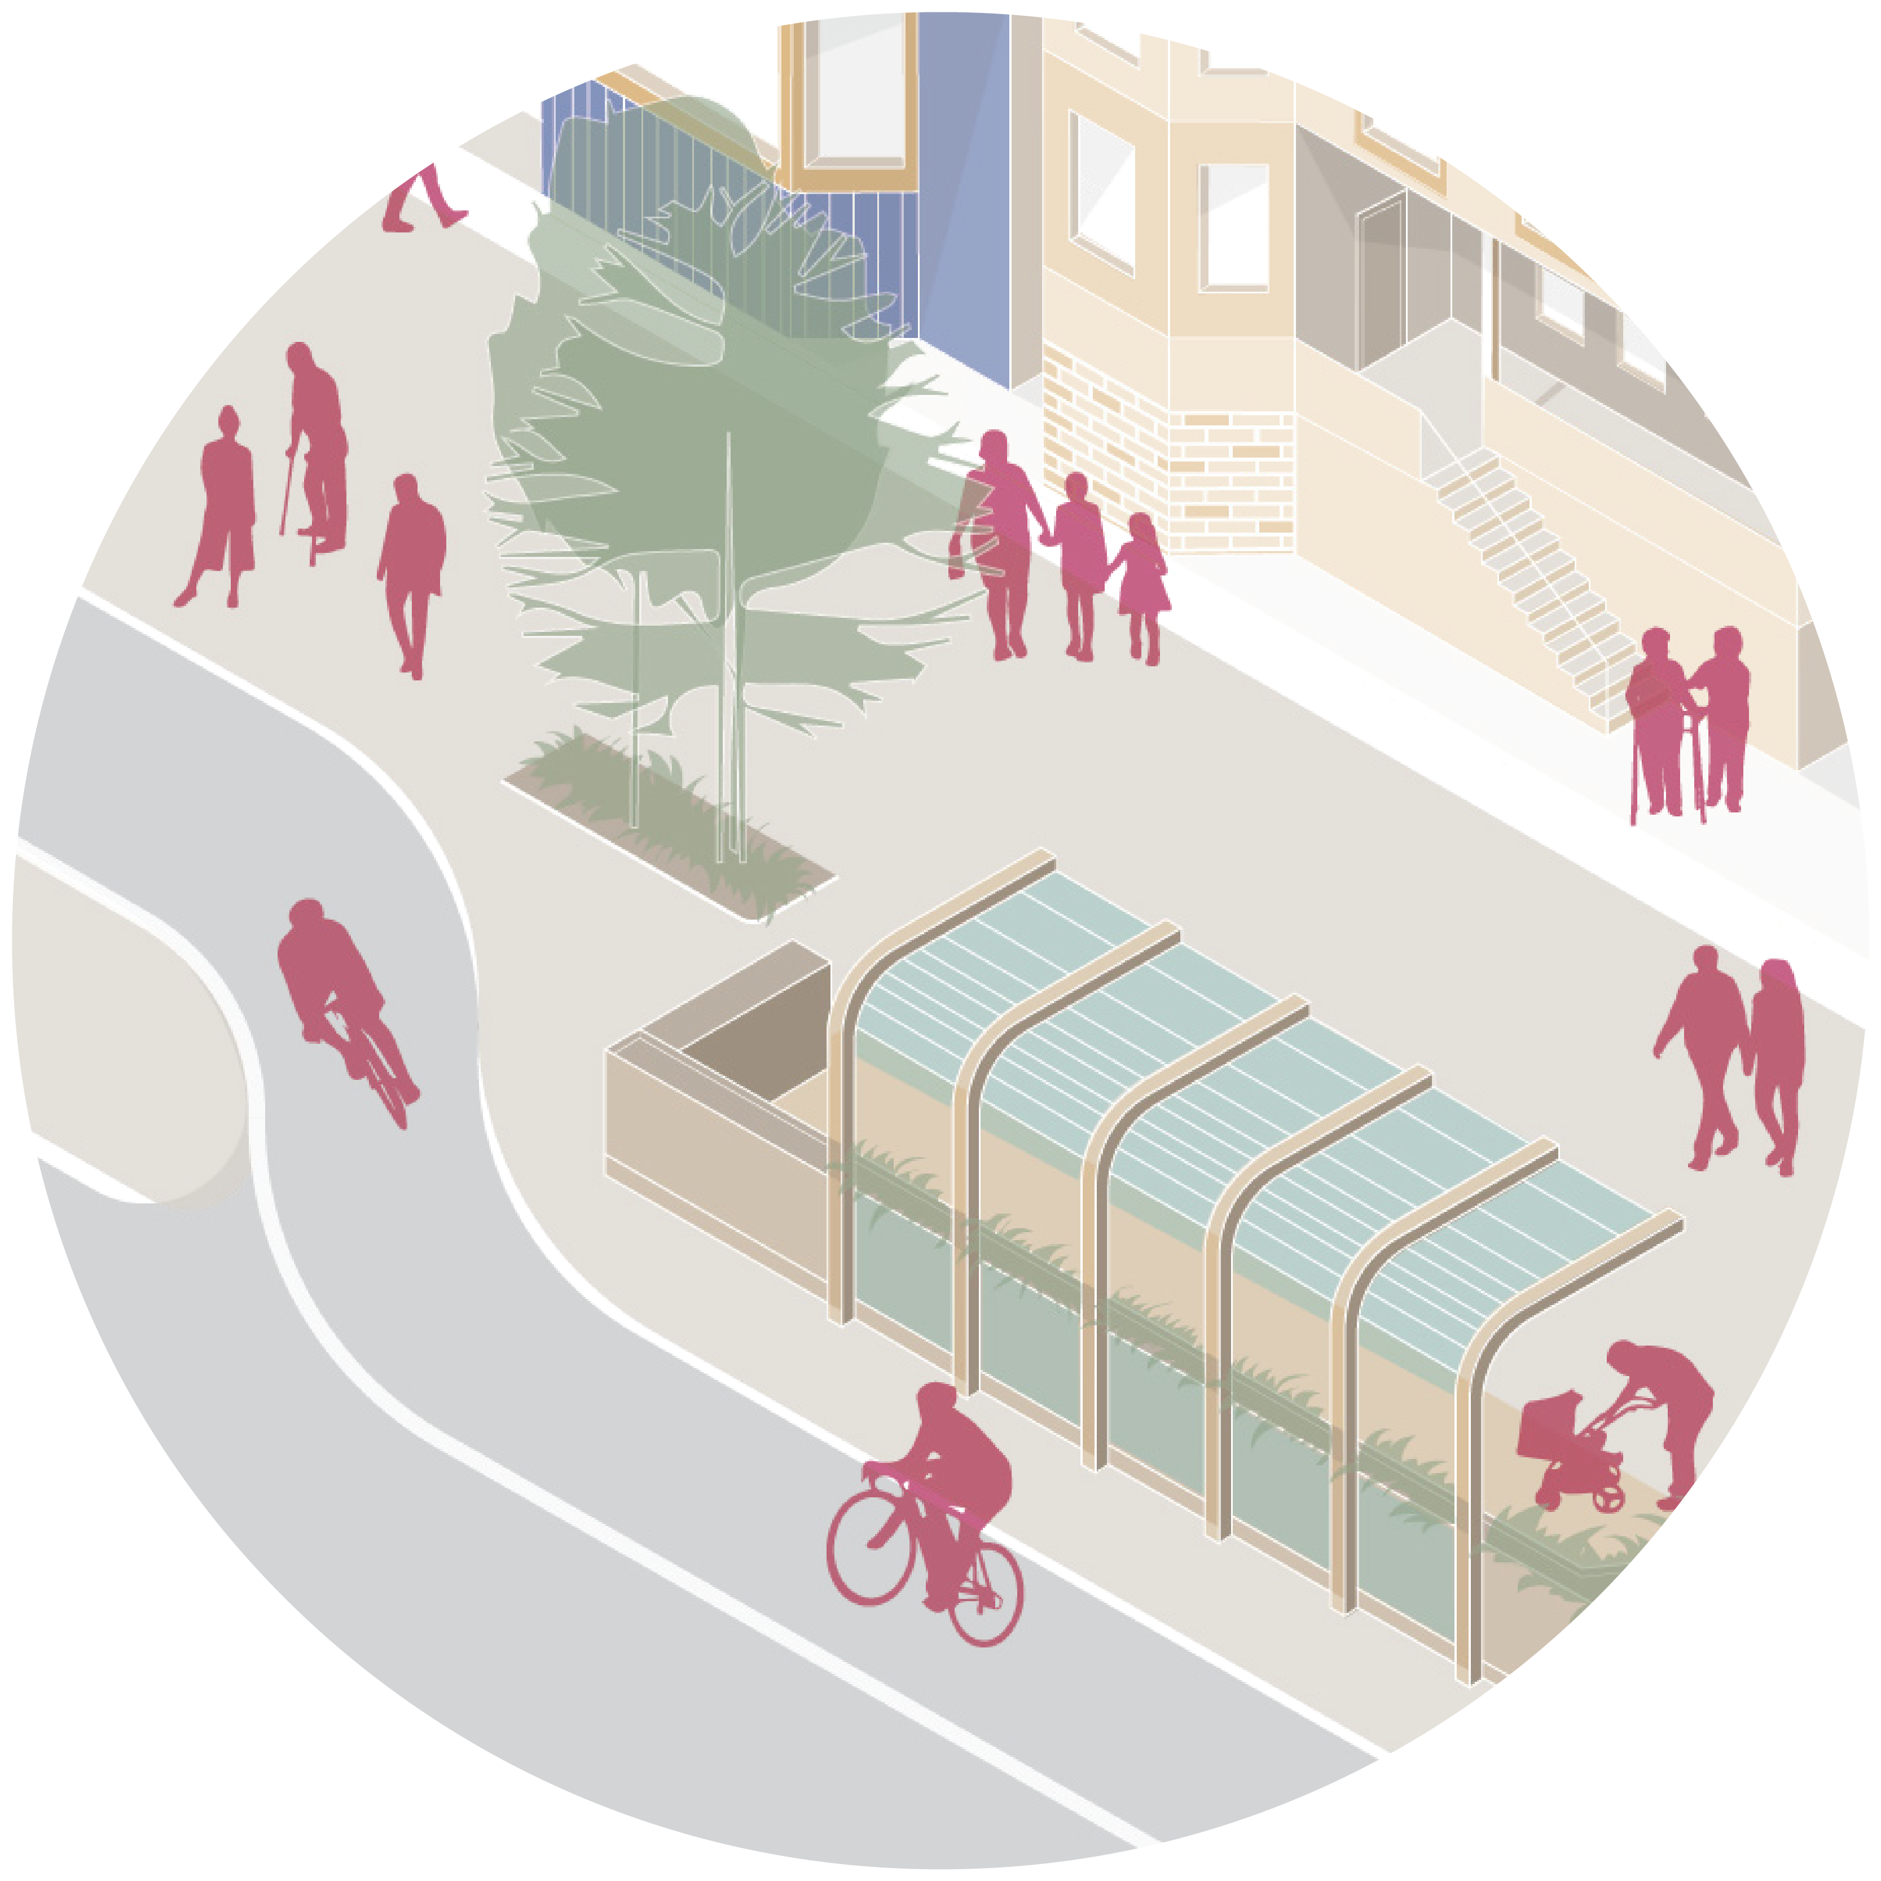
REGIONAL ACTION
REGIONAL ACTION
Strengthen regional planning agencies or create new regional governance models.
Encourage more voluntary coordination through initiatives like the Metro Mayor’s Coalition.
Allow for regional ballot initiatives.

Slide 4
LOCAL ACTION
LOCAL ACTION
Plan with communities, instead of for communities.
Plan at the “speed of trust.”
Provide childcare.
Provide adequate translation services.
Ensure that professional planning staff are representative of the community.
Design for people, not cars.
Reform zoning for density, mixed-use, and income-restricted housing.
Tax growing local economies to fund equity-focused investments.

Slide 5
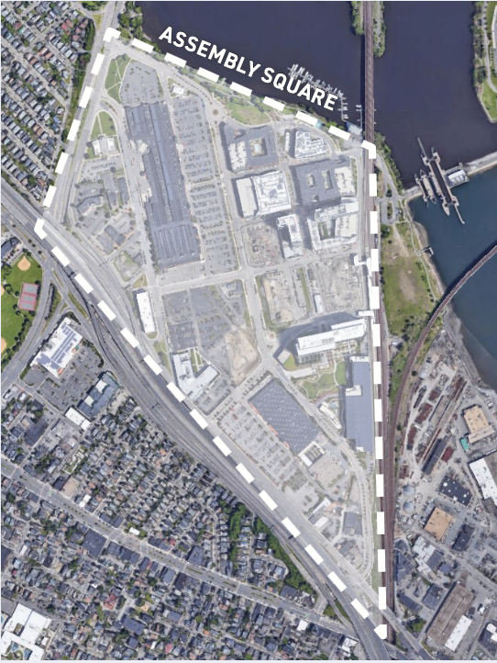
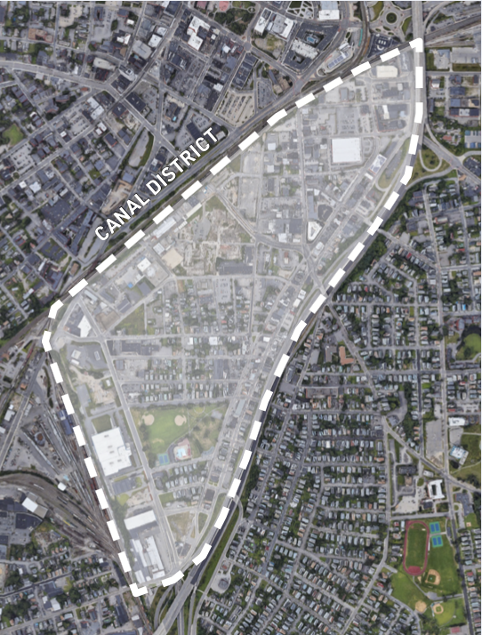
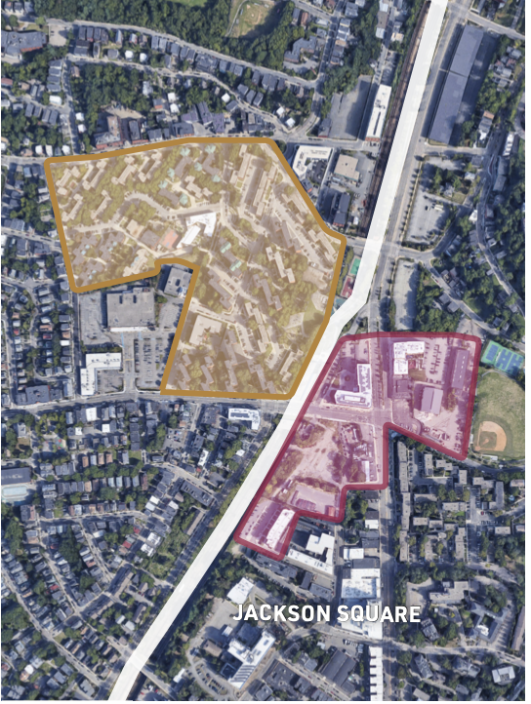
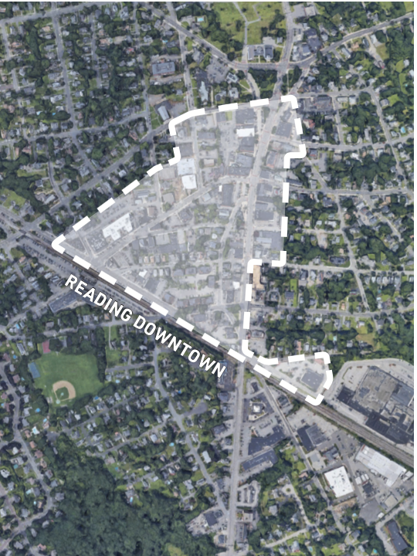
CASE STUDIES OF FOUR NEIGHBORHOODS MOVING IN THIS DIRECTION
Assembly Square, Somerville
Canal District, Worcester
Jackson Square, Boston
Reading Downtown

